Slide 1
USING Labour migration to BUILD resilience in sending communities
Luke Craven, University of Sydney

Slide 2
How we think about resilience
A combination of two elements:
The capacity of exposed individuals to adapt.
The processes that intensify risk and inhibit adaptive capacity.
Question: how do temporary labour migration schemes affect adaptive capacity in sending communities?
How can these schemes be designed to ensure contributions to adaptive capacity are maximised?

Slide 3
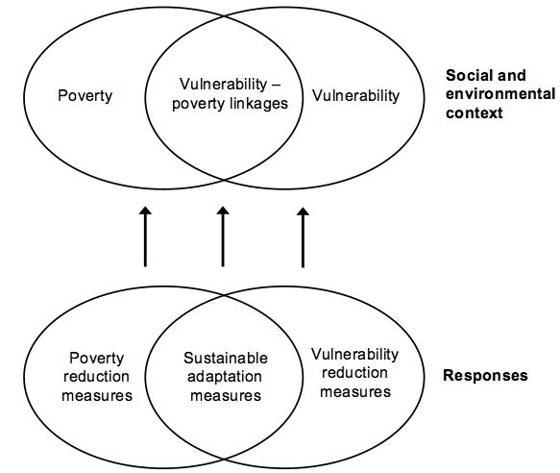
Conceptual overview of vulnerability-poverty linkages

Slide 4
My key findings from Vanuatu
Migration is both a cause and consequence of local vulnerabilities.
Migration has adverse consequences on a number of factors which contribute to adaptive capacity:
Local food security
Social capital and community cohesion
A overreliance on unsecure revenue streams
TLMPs can be better designed to mitigate these problems.

Slide 5
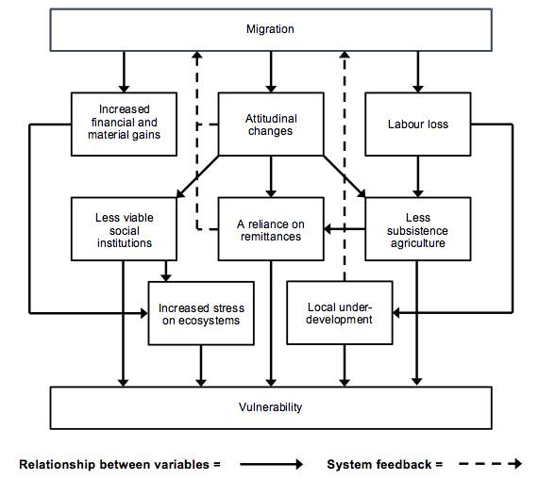
Conceptual overview of findings

Slide 6
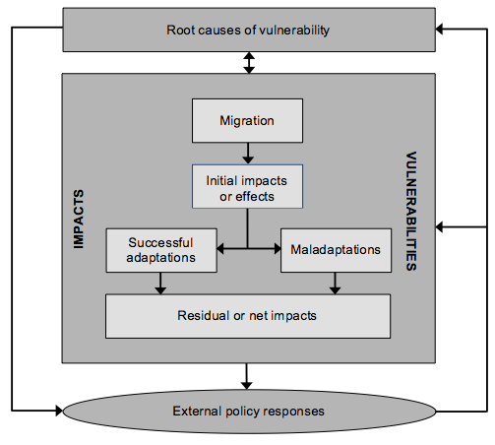
Making migration resilience-friendly

Slide 7
Creating more effective TLMPs
Population mobility is not a replacement for other forms of development assistance.
Designing better recruitment processes.
Establishing mechanisms to encourage ‘community remittances’
Involving local communities in policy development.
Involving employers in impact assessment.

