Slide 1
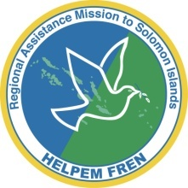
Information in Natural Disasters – crisis, adaptation, communication SOLMAS RESEARCH 2013
Notes:
Thank yous… Introduce team

Slide 2
OUTLINE
Role of information in community resilience – findings from global study
Case study research – Solomon Islands (use of local and global materials)
Implications and recommendations (local and global)

Slide 3
COMMUNITY RESILIENCE
Global study of community response to disaster in five locations (Kenya, Myanmar, Solomon Islands, Pakistan, Indonesia)
Primary source of information – neighbours, extended family, social networks
Cooperation and action in these groups high in initial response to disaster (before aid)
Aid operates on top of these networks and often subverts it (from decision-making to waiting in line, lack of control, dependency, economic distortions)
Need for information that is citizen-centered, appropriate to local cultures, build on resilient networks and communication styles

Slide 4
Pakistan earthquake – popular outsider images “victims” are alone, helpless
Notes:
“Victims”, images of a sole person with a backdrop of destruction, commonly spread in international media
Victims often presented shoulders rounded, chin down, long face, energy drawing back in on itself
This one from Life magazine features common framing – 1 individual sitting alone amongst devastation
http://www.life.com/image/55939703

Slide 5
Pakistan flood – common images from insiders: survivors are cooperative, active, responding as groups
Notes:
People trying to repair a breach in flood wall – image from South Asia Relief, a group of web and IT specialists from South Asia coordinating information and donations
http://jehanara.wordpress.com/2010/08/17/google-assists-pakistan-flood-relief-efforts/

Slide 6
RESEARCH NEED
ABC International Development, through SOLMAS had done extensive work with the SI NDMO and SIBC to build capacity for disaster broadcasting and awareness.
two key areas emerged as knowledge gaps:
1. The effectiveness of the standardised awareness messages developed by international donors for use by NDMO?
2. Media and communications ecology of SI communities in preparation and response to natural disasters?
Notes:
Formative, pre-testing and content testing is key to the ABC International Development approach to media and communications for development.

Slide 7
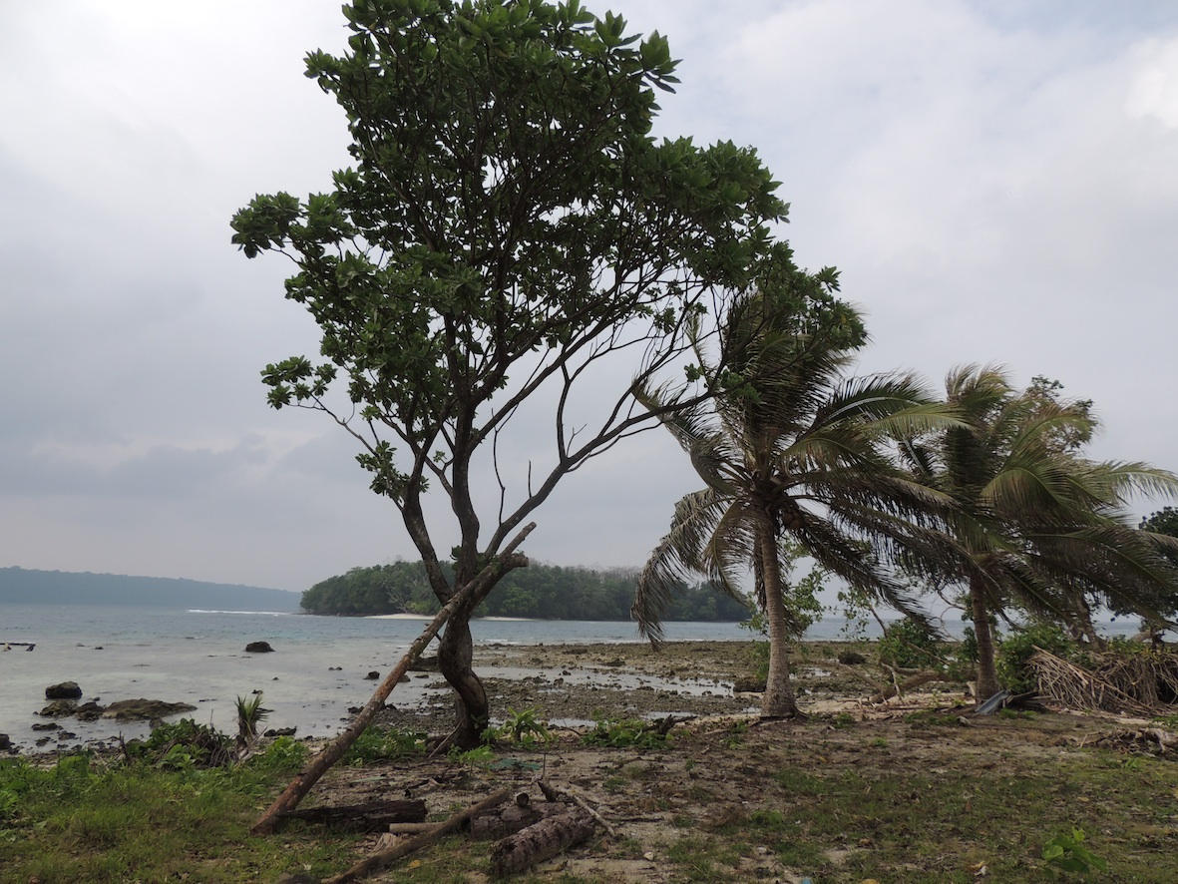
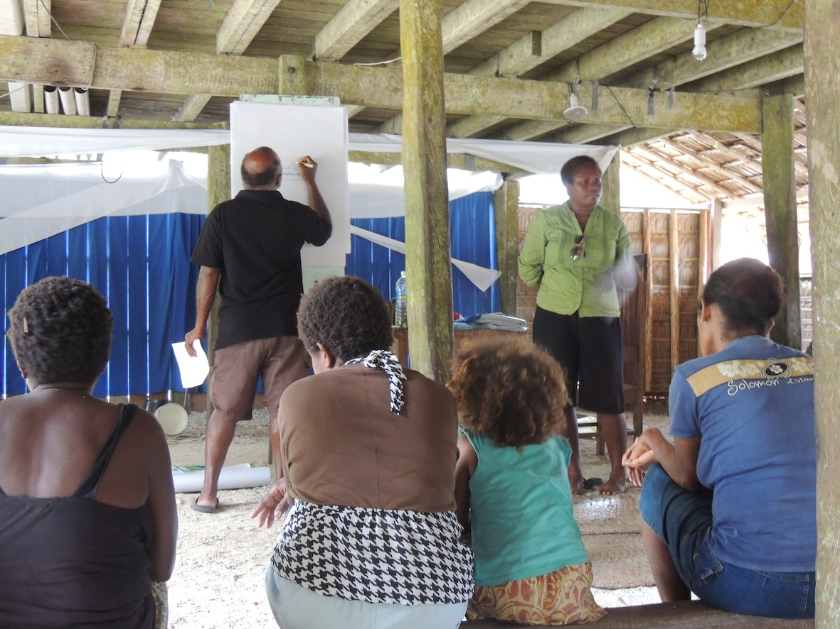
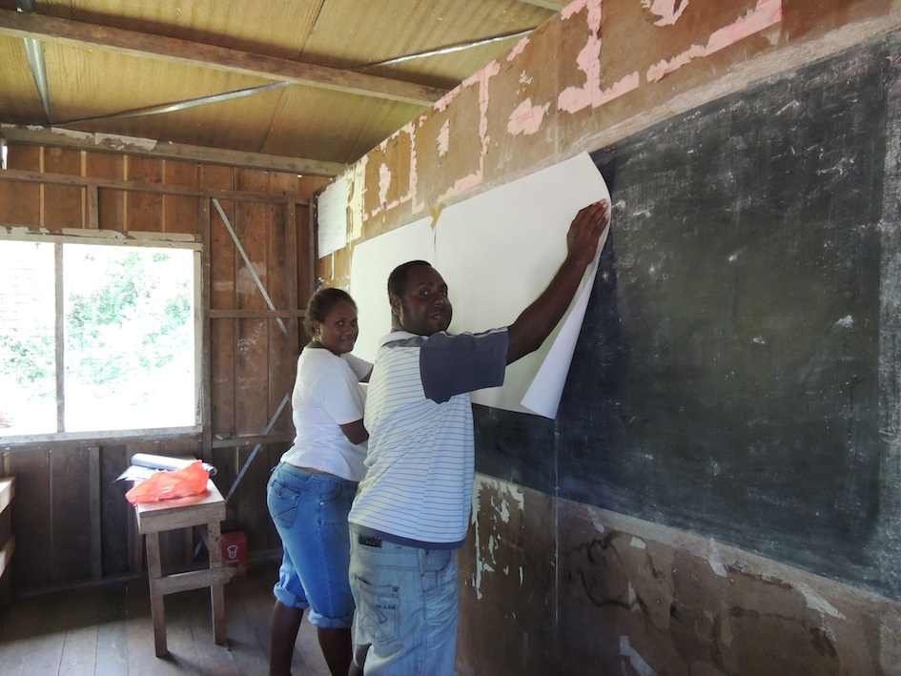
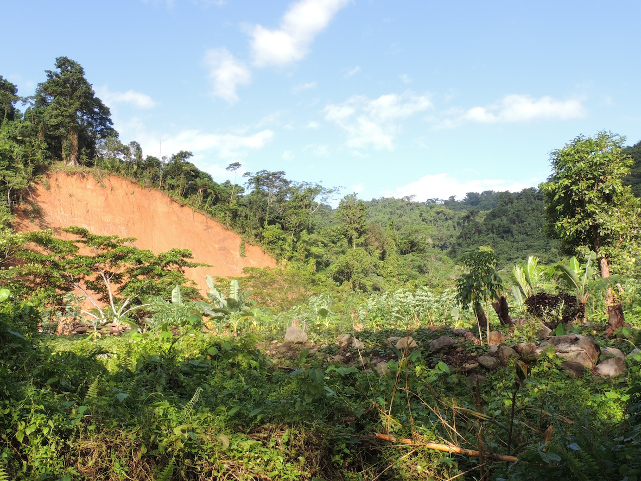
Notes:
Our case study – Solomon Islands
Kuma - heavy rain and flooding for 6 months, landslides, shortage of food, closure of schools
Nea – tsunami in February 2013, loss of houses, food, supplies, some still living in temporary accommodation, some rebuilt
Both limited loss of life (2 people in broader Nea region, 0 in Kuma)
Adaptation in some ways, vulnerability still exists

Slide 8
SI CASE STUDY OUTLINE
Research report to look at info in natural disasters – what people know, what they need to know, how they want information
2 communities – Nea in Temotu, Kuma in Weathercoast
Each community 3 x focus groups – women, men, youth, with focus on leaders in each
Focus groups run over 2 days in each location
Total 73 people participated in research

Slide 9
INFORMATION TESTED
Notes:
Posters (global), Radio (local), TV ad
Exposure to information – radio ads previously heard, posters and tv ads new
Kuma very limited NGO/govt presence (World Vision), Nea more exposure (Red Cross, others) but no radio or phone reception

Slide 10
INFORMATION TESTED

Slide 11
Findings - Weathercoast
Major info lack – food preparation and storage in prolonged rain and flooding
School students (particularly boarders) particularly vulnerable
Information from Honiara (e.g. weather) seen as not applicable to region, request for “two way” information about weather and advice
Request for awareness about all disasters

Slide 12
Findings - Weathercoast
People recalled radio ads well, new info in radio ads was idea to listen to radio for updates, not to fish in times of flood
Posters not well recalled, alert system seen as confusing
Pictures of what disaster alert levels looked like and how to prepare seen as most useful
Confusion/mixed recall around idea of emergency kit

Slide 13
Findings - Weathercoast
People liked central message of TV: do not underestimate power of nature
Request for footage of Solomon people and places, slower pace, step by step approach
Dramatisation (in tv and awareness) preferred
Pijin preferred over English (some also preferring local language)
Distribution in local hubs e.g. clinic, halls, schools

Slide 14
Findings - Temotu
Importance of oral stories and first hand experience
“Dadi blo mi storim kam lo mifala dat if ert kuek en tsunami kasem mifala ae ufala save go lo ples osem, hem talem kam na wat fo duim en ples fo go lo hem so mifala folom en no eni wan lo mifala dae”
“My father told us what to do when there is an earth quake and tsunami, he told us where we would be safe and where to run to, so we followed his instructions during the tsunami and none of us ended up dead” (Women’s focus group)
“Mifala garem olketa ivakueison saet wea olketa grani talem mifala so taem si ia hem drae mifala save na ia tsunami kam na en mifala save wean a fo run”
“We have evacuation sites where our grandparents told us so when we saw that the sea was dried up we knew that a tsunami was coming and we knew where to run to” (Youth focus group)

Slide 15
Findings - Temotu
Earthquakes/tsunami advice could be made more practical (e.g. hide under table not useful, feeling of pre-tsunami quake useful, step by step approach)
Awareness/drills also helped people prepare (but some gaps e.g. evacuation sites, emergency kits)
No access to technology/communication
School students particularly vulnerable
Adaptation limited (because of services)

Slide 16
Findings - Temotu
Men and youth recalled some of posters, particularly pictures, women no recall
Earthquake/tsunami seen as similar so need for common advice about what to do
Cartoons not seen as appropriate
Main messages must be in pictures
Women and youth wanted focus on what to do/advice against panic

Slide 17
Findings - Temotu
Radio should be slower, serious, use real sounds and voices
TV – English severely limited comprehension of materials, also need for a clear logic to advice and images showing preparation

Slide 18
RECOMMENDATIONS

Slide 19
TEST MATERIALS
* Information materials should be tested with communities to assess whether the materials are comprehended, hold attention of their audience and whether they are perceived as likely to influence behaviour in relation to preparedness and response to natural disasters.
*Distribution of materials should be at the family level
*People isolated from normal social support networks (notably boarding school students) should be especially included in distribution of visual materials and awareness programs

Slide 20
USE RADIO & PHONES MORE EFFECTIVELY
*Radio information and mobile phones for remote communities should be prioritized as an effective way to reach the maximum number of people in disaster affected communities.
*Weather/meteorology reports and information about natural disasters should be linked in radio programming
*Radio programs could also help facilitate “two-way” communication between disaster affected communities and relevant authorities
*Options for agencies to send disaster warnings and advice via mobile phone text message should be explored

Slide 21
GO VISUAL
*Materials should be highly visual. Key messages about how to keep safe should be readily understood from pictures, films or theatre.
* Showing and tell “real life” Solomon people preparing and responding to disasters. Content should be as local as possible and in Pijin or local languages.

Slide 22
ADDRESS YOUTH & DISABILITY VULNERABILITY TO DISASTERS
*Schools, particularly those with boarding students, should be particularly targeted for awareness and community development programs that help plan for natural disasters, given the isolation of many students from families and normal ‘wantok’ social support systems during disasters.
* Educate - Information about natural disaster preparedness and response could be incorporated into the Social Sciences and Sciences curriculum
*Community rehabilitation officers and other organizations working with people with disabilities should be consulted on awareness programs

Slide 23
INCORPORATE TRADITIONAL KNOWLEDGE
People's collective experiences - traditional knowledge, skills and behaviour patterns - need to be recorded to ensure that traditional knowledge of survival and coping techniques during a natural disaster are passed on to future generations. This will help embed traditional disaster preparedness responses as cultural norms for future generations and ensure that they continue to form a part of people’s reflex response to natural disasters.

Slide 24
ACTIONS ARISING FROM RESEARCH
Research informed communication strategy (now adopted)
Research used in development of new communications materials (phone/radio)
Research to inform Disaster Risk Reduction Committee - Red Cross, World Vision, Save the Children, Oxfam, ADRA, Ministry of Health, Ministry of Education

Slide 25
IMPLICATIONS
Assessment of literacy, local communication networks, preferred media outlets, prior knowledge important to make information effective
Working with pre-existing social networks most likely to be effective
Information should be action-orientated, practical community-focused
Traditional knowledge can both enable (Temotu) and limit (Weathercoast) adaptation, need to share information about resilient local responses

Slide 26
Thank you
Anouk Ride
anouk.ride.com@gmail.com
www.anoukride.com

