Slide 1
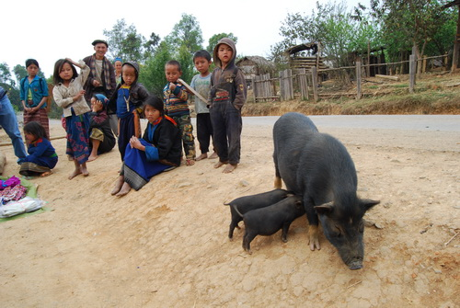
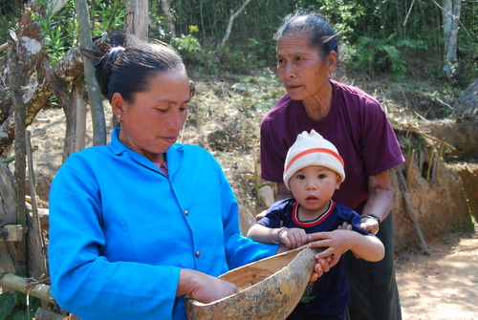
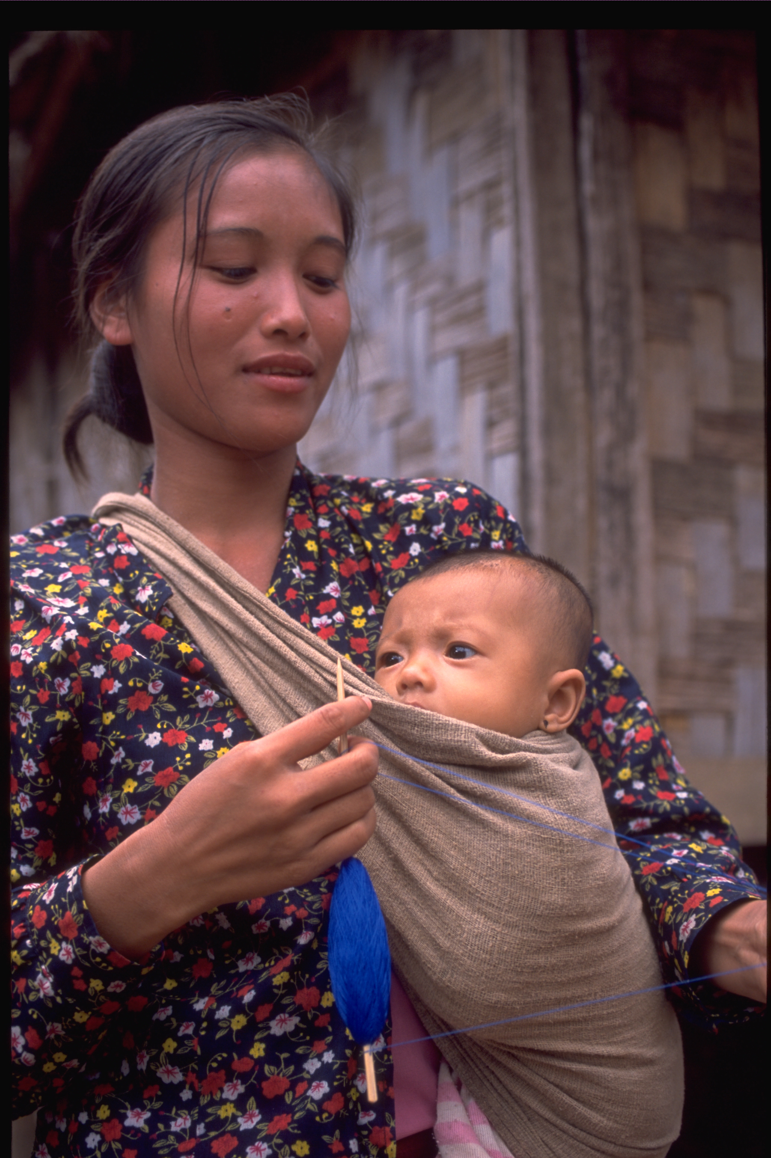
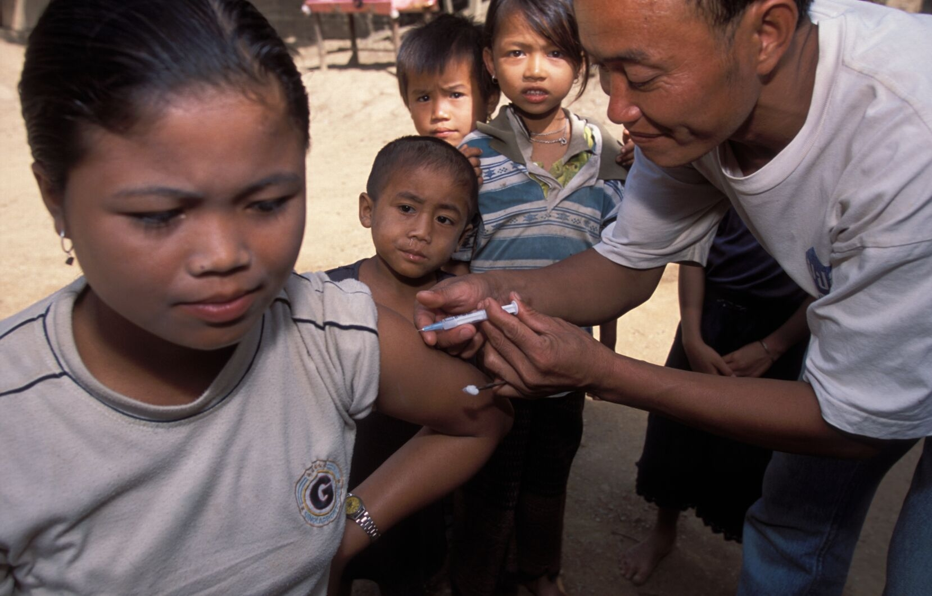
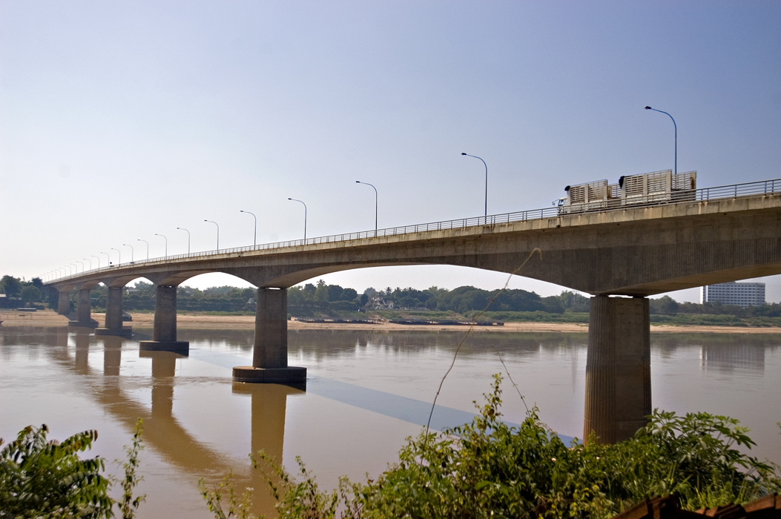
The impact of foreign aid from traditional donors on the quality of government in a one-party state (the case study of Laos)
Phanthanousone (Pepe) Khennavong
PhD candidate - Public policy programme Crawford School of Economic and Governance
Principal Supervisor: Stephen Howes

Slide 2
Presentation Outline
Introduction
Literature review
Research methodology
Findings
Conclusion

Slide 3
I. Introduction
1 | Research question Have traditional aid donors to Laos succeeded in stimulating positive changes in the quality of government? If so, how?
2 | Why aid and governance in Laos? Since 1995, significant increase of aid for governance in Laos – similar to the global trend in helping developing countries to fight against poverty 85% - foreign aid share of government public investment program Increasing interest on how aid can influence governance in one party states – Laos is a few of them.

Slide 4
II. Literature review
Three categories of the arguments against the proposition that aid can be used to improve governance
1 | Domestic institutions change slowly, and are largely determined by domestic politics over which donors have little influence
2 | Tools donors have for addressing governance often have little influence. criticisms of conditionality and technical assistance.
3 | Far from improving governance, aid can in fact make it worse. Poorly designed and implemented aid = increased rent-seeking, corruption or even violence. Poor aid = weaken accountability to domestic voters, which can have an adverse impact on performance
1st and 2nd argument still allow for aid to have an influence on the margin but they are not decisive. 3rd argument suggests aid in fact will have a negative influence

Slide 5
III. Literature review (cont’d)
Most of the evidence supporting the negative influence of aid on governance = cross country regressions.
Knack (2000) – Aid could potentially exacerbate corruption and has negative impact on the rule of law & bureaucratic quality
Aleina and Weder (2002) - high level of foreign aid in poor countries can increase the level of corruption.
Djankov et al (2008) - high level of foreign can undermine their institutions
However, a significant body of literature critiquing cross-country aid regressions and their lack of reliability. Ear (2007) critiques Knack (2000) - “the causal link between aid dependence and worsening quality of governance may be tenuous at best and sensitive to alternative specifications”. The alternative approach is one based on case studies like what Ear (2007) did for Cambodia – from the country survey – Ear (2007) highlights that aid failed to improve governance except for political stability and may have worsened corruption

Slide 6
III. Literature review (cont’d)
The current literature seems to have two key limitations.
1 | It is heavily biased in the direction of cross-country regressions which may be unreliable. It often assumes that the impact of foreign aid on quality of government is likely to be homogenous across countries
2 | There are very few case-studies, and those that are lack direct insight into the perspectives of government officials. Ear (2007)’s findings, for instance, very much based on perspectives from donor community = 84% of the survey’s respondents worked for donor agencies and Non-Profit Organizations (NGOs)
Notes:
Hughes demonstrates that the clientelist strategies of Hun Sen, Cambodia's postwar leader, have created a shadow network of elites and their followers that has been comparatively effective in serving the country's villages, even though so often coercive and corrupt.
East Timor's postwar leaders, on the other hand, have alienated voters by attempting to follow the guidelines of the donors closely and ignoring the immediate needs and voices of the people.

Slide 7
III. Research methodology
Approach - A qualitative case study
1) Survey
- | Replicated Ear’s (2007) elite survey on aid and governance based on Kaufmann et al.’s six dimensions of governance (voice and accountability, rule of law, control of corruption, regulatory quality, political stability, and government effectiveness)
- | Extended to a larger group of respondents especially more government officials
2) Semi-structured in-depth interviews
- | Mostly open ended questions
- | Looked for justification on the ratings by research participants
3) Analysis of reports and documents
- | Reviewed Government documents and donor briefings, evaluation and reports

Slide 8
Survey
I. Survey launched at the end of September 2011 – closed in late August 2012
 | Key question - For each of six dimensions of governance, please indicate whether you believe that the donor community as a whole has succeeded in stimulating positive changes in the quality of government (Ear 2007)
II. The response rate was 75% of the relevant informed population of 80
III. Criterions for the relevant informed population
 | Working in Laos not less then five years Direct knowledge of aid and development in the country
IV. Rating on donor success
- | Ratings – negative, none, poor, medium, high and very high
- | To avoid response bias, rating included a ‘not sure/don’t know’ option

Slide 9
Respondents for Ear’s study = 43 people (84% of them are representing donor agencies)
Composition of respondents
Descriptions |  |  |  | Number | Percentage | Male | Female | Average working experience | Median
Total research participants |  |  |  | 60 |  | 39 | 21 | 17 | 15
 | Government officials |  |  | 31 | 52% | 21 | 10 | 18 | 15
 | Donor representatives |  |  | 29 | 48% | 18 | 11 | 15 | 15
 | Government officals in total |  |  | 31 | 52% | 21 | 10 | 18 | 15
 |  | Gov't Official - Senior (58%) |  | 18 | 30% | 12 | 6 | 24 | 23
 |  | Gov't Officials - Manager (26%) |  | 8 | 13% | 7 | 1 | 12 | 12
 |  | Gov't Officials - Technical (16%) |  | 5 | 8% | 2 | 3 | 6 | 6
 | Donor representatives in total |  |  | 29 | 48% | 18 | 11 | 15 | 15
 |  | Officials working with donor agencies (48%) |  | 14 | 23% | 9 | 5 | 14 | 15
 |  | National expatriates working with the Government (28%) |  | 8 | 13% | 4 | 4 | 17 | 15
 |  | International expatriates working with the Government (14%) |  | 4 | 7% | 4 | 0 | 18 | 15
 |  | Non-Government Organizations ( NGOs) (10%) |  | 3 | 5% | 1 | 2 | 13 | 10

Slide 10
Kaufman’s results do not show much improvement in governance but this does not prove that aid has been ineffective: What is the counterfactual? They are relative rankings They are based on cross-country surveys which may or may not be reliable

Slide 11
IV. Findings
1 | Two clear clusters of results
 | Successful cluster | Ratings - Medium to Very high | Unsuccessful cluster | Ratings - Medium to Very high
 | Voice and accountability | 80% | Control of corruption | 8%
 | Government effectiveness | 85% | Regulatory quality | 27%
 | Rule of law | 90% | Political stability | 18%
2 | Both donors and government officials seem to provide true and fair comments
3 | None thought that donor supports have a negative impact on the quality of government in Laos
4 | Not much difference in the ratings by donors and government officials

Slide 12
Survey results
Governance Dimensions |  | None | Poor | Medium | High | Very high | Total | None to Poor | High to Very high | Medium to Very high
Voice and accountability
 | Gevernment & donor | 0% | 20% | 30% | 46% | 3% |  | 20% | 50% | 80%
 |  | 0 | 12 | 18 | 28 | 2 | 60
 | Government only | 0% | 13% | 32% | 52% | 3% |  | 13% | 55% | 87%
 |  | 0 | 4 | 10 | 16 | 1 | 31
 | Donor only | 0% | 28% | 28% | 41% | 3% |  | 28% | 45% | 72%
 |  | 0 | 8 | 8 | 12 | 1 | 29
Political stability
 | Gevernment & donor | 69% | 13% | 17% | 0% | 2% |  | 82% | 2% | 18%
 |  | 41 | 8 | 10 | 0 | 1 | 60
 | Government only | 58% | 19% | 19% | 0% | 3% |  | 77% | 3% | 23%
 |  | 18 | 6 | 6 | 0 | 1 | 31
 | Donor only | 79% | 7% | 14% | 0% | 0% |  | 86% | 0% | 14%
 |  | 23 | 2 | 4 | 0 | 0 | 29
Government effectiveness
 | Gevernment & donor | 2% | 13% | 32% | 43% | 10% |  | 15% | 53% | 85%
 |  | 1 | 8 | 19 | 26 | 6 | 60
 | Government only | 0% | 10% | 32% | 39% | 19% |  | 10% | 58% | 90%
 |  | 0 | 3 | 10 | 12 | 6 | 31
 | Donor only | 3% | 17% | 31% | 48% | 0% |  | 21% | 48% | 79%
 |  | 1 | 5 | 9 | 14 | 0 | 29

Slide 13
Survey results (Cont’d)
Governance Dimensions |  | None | Poor | Medium | High | Very high | Total | None to Poor | High to Very high | Medium to Very high
Regulatory quality
 | Gevernment & donor | 8% | 65% | 24% | 2% | 2% |  | 73% | 3% | 27%
 |  | 5 | 39 | 14 | 1 | 1 | 60
 | Government only | 10% | 74% | 16% | 0% | 0% |  | 84% | 0% | 16%
 |  | 3 | 23 | 5 | 0 | 0 | 31
 | Donor only | 7% | 55% | 31% | 3% | 3% |  | 62% | 7% | 38%
 |  | 2 | 16 | 9 | 1 | 1 | 29
Rule of law
 | Gevernment & donor | 0% | 10% | 35% | 54% | 2% |  | 10% | 55% | 90%
 |  | 0 | 6 | 21 | 32 | 1 | 60
 | Government only | 0% | 13% | 42% | 45% | 0% |  | 13% | 45% | 87%
 |  | 0 | 4 | 13 | 14 | 0 | 31
 | Donor only | 0% | 7% | 28% | 62% | 3% |  | 7% | 66% | 93%
 |  | 0 | 2 | 8 | 18 | 1 | 29
Control of corruption
 | Gevernment & donor | 55% | 37% | 8% | 0% | 0% |  | 92% | 0% | 8%
 |  | 33 | 22 | 5 | 0 | 0 | 60
 | Government only | 61% | 32% | 6% | 0% | 0% |  | 94% | 0% | 6%
 |  | 19 | 10 | 2 | 0 | 0 | 31
 | Donor only | 48% | 41% | 10% | 0% | 0% |  | 90% | 0% | 10%
 |  | 14 | 12 | 3 | 0 | 0 | 29

Slide 14
IV. Findings (cont’d)
5 | Reasons from the interviewees for successful cluster Donors have been able to work with local actor to convince the party that some reforms have no harm to the current Lao political regime. Given the politically difficult situation, donors put more emphasis on three key priorities in supporting the reform: voice and accountability, government effectiveness and rule of law compared to other three dimensions. Understanding donor priorities, the Government has been strategic to be responsive to reform in order to maintain donor support
6 | Reasons from the interviewees for un-successful cluster Political stability has nothing to do with donor community in Laos and donors and the Government made it clear that Western supports come with no political interference The World Trade Organization (WTO) accession = a sharper incentive for reform of the regulatory quality rather then aid Corruption is in the “too hard” basket. Government does not want an external pressure on this and donors put this issue to one side.

Slide 15
IV. Findings (Cont’d)
7. Comparison with the results by Ear (2007)
Description | Dimensions of governance | Rating from Medium to Very high (Laos vs Cambodia)
Similar results | Regulatory quality Control of corruption | 27% vs 29% 8% vs 7%
Different results | Voice and accountability Political stability Government effectiveness Rule of law | 80% vs 47% 18% vs 67% 85% vs 30% 90% vs 12%
Key explanation for these differences
a | Positive relationship and trust between the Lao Government and donor community – High then in Cambodia
b | Donors have been more careful in managing their expectations and able to work with local actors
c | Strategic use by the Lao Government of donors Responsive to the reform agenda in some areas to maintain donor support Progressive governance reform = pressure on the current regime

Slide 16
A donor informant with 15 years of working experience in Laos… “When we talk about governance reform in Laos, it is important that we need to manage our expectations well because they are so many constraints that we are facing. The most important thing for us is to work well with local actors who will take things further. So, setting a comprehensive and ambitious agenda will only push things backward as the government will not keep up with a radical overhaul”
A donor informant with 20 years of working in Laos … “Back then we focused on technical level to gain trust and confidence from government officials. It took us almost a decade to explain the concepts, coordinate our activities and negotiate what needed for the reform to happen. Then at political level, a lot of efforts went to dialogues and partnership building with senior government officials. As a result, we how have the governance strategy and a proper implementation and monitoring mechanism for governance reform in Laos”.

Slide 17
A national expatriate working with the Government for over 15 years ….”Donors should receive a credit for helping the government to implement key activities for improved government effectiveness. I remember a decade ago, things didn’t progress at all. There were only ideological discussions based on old concepts. But now, with donor support, you see actions and things start to move into a positive direction. ……..For Instance, Without donors, I doubt it whether there would be anything for service delivery”
A government informant with 30 years of working experience ….”We understand donors’ priorities but we also need to be mindful about how to maintain the legitimacy of our current political system. Therefore, we are now working on how to create formal and proper channels for people’s participation based on local context but using international practices as a guideline. Step by step, this will help us to satisfy donors’ expectation and hopefully this will mean more support in the future”

Slide 18
A government informant with 35 years of working experience …”Within less then 10 years that the government and donors have been working together on people’s participation, we now have the Prime Minister Decree on association. Local NGOs are now allowed to be established in Laos. For sure, this is a sign that the Party starts to understand and accept the modern concept of people’s participation. ….. Without donor support in this area, we would have not been where we are today. Indeed, it may get worse I would say”
A government informant with 25 years of working experience ….. “I think the international community has helped us to be more strategic on rule of law reform. We, the government, tend to have many objectives and visions but do not have capacity to put things that we want into a complete, clear and coherent framework. So, with donor support, I think we are now more realistic with our objectives and vision as shown under the legal sector master plan. Also, with our limited knowledge, donors help a lot in term making sure that our domestic laws and regulations are consistent with international provisions that Laos must comply with. Well, without donor support, we might not be where we are today regarding to the rule of law in Laos.

Slide 19
V. Conclusion
1 | Results of the survey in Laos Mixed views Consistent across various groups of respondents
2 | Two clear clusters of donor success in stimulating positive changes to the quality of government in Laos
 | Successful cluster Voice and accountability Government effectiveness Rule of Law | Un-successful cluster Political stability Regulatory quality Control of corruption
3 | Key ingredients for successful donor influence on the quality of government in Laos
 | Positive relationship and trust Managing expectations and working with local actors Understanding the Government’s strategic position on governance reforms
4 | Implication
 | Be wary of cross-country generalizations The influence of aid depends on the type of governance

Slide 20
Thank you
Q&A

