Slide 1
Revising the role of contract in development cooperation
Elizabeth Crawford Spencer
Associate Professor
Australian Catholic University, Sydney
2014 Australasian Aid and International Development Policy Workshop Development Policy Centre, Crawford School of Public Policy, ANU and The Asia Foundation. February 2014

Slide 2
A landscape of increasing multilateral aid and partnering
Challenges of increasing multilateral aid and partnering in development cooperation
Importance of local nongovernmental organizations (LNGOs) in development cooperation
Partnering arrangements as a means of interpreting relationships

Slide 3
Method
25 semi-structured interviews
2 phases (March & August 2013)
Constant comparative method
Desk research
Content analysis (Second phase)

Slide 4
What they said…
‘They should love our people. They should respect.
… You come, you are welcome, but you don't come with your heart.’
– U Maung Maung Soe Tint,
Chairman of Myanmar NGO Network,
Chairman of Myanmar NGO Contingency Plan
Steering Committee

Slide 5
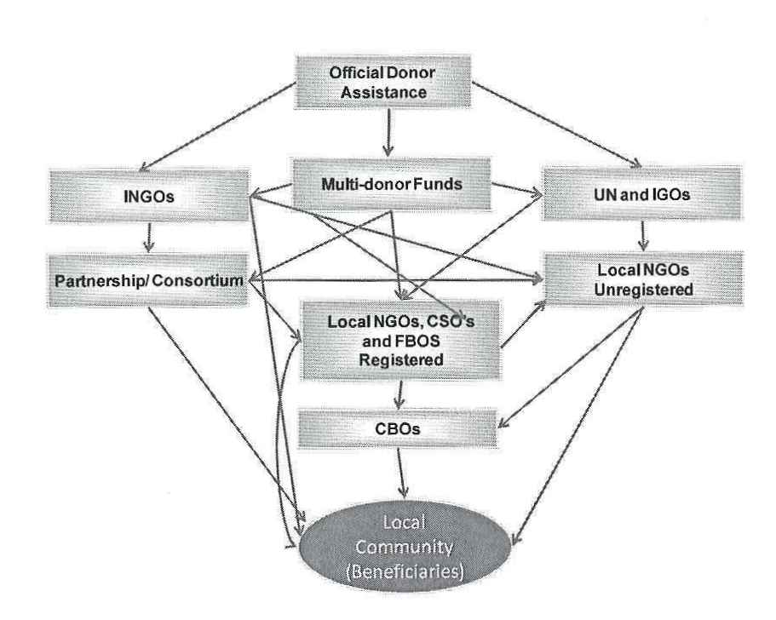
What they said…
Development funding has many steps - like a distribution channel - as well as networks horizontally and diagonally, leading to ambiguity over roles and accountabilities
Diagram from Bridging the Gap Report
Issues over roles and accountabilities:
‘We’re not a donor but a partner. But they see us as donors anyway.’

Slide 6
What they said…
Alignment of interests…
e.g. project-based funding, outcome-oriented delivery mechanisms, short-term horizons
‘Donors won’t agree to raise local salaries. 30% of total budget is admin – no more. Rents very high in Yangon. We have to move. But we can’t afford space.’
‘Have to wait 2 months to buy a new drum for printer (100K kyat).’
‘Donors do not see the goal of the partner organization – only support the project. Period. Alignment – objectives are not the same.’
‘Some strategies aren’t linked to donor requirements so hard to get funds.’

Slide 7
What they said…
‘Donee needs long term, while donor is focused on short-term results.’
‘If you look at agreement requirements of donors, all small amounts, all different requirements and reporting requirements. Can't spend money on administration, but all of this is administration. There are about 50 staff members, but donors just want ‘project activity’ - won't pay for administration costs.’
‘not just activity costs …also fund program and personal costs, second most important need longer-term agreements.’

Slide 8
What they said…
Competition for funding
The dynamics of competition discourage cooperation
‘…the one that wins doesn’t share the winning proposal. So they don’t know what they’re doing wrong. Very competitive, business minded, so not sharing their niche.’ ‘Compliance officers – come not to help but to find fault.’
‘They told the LNGO people – stay on the boat and they talk to the community. Donors need to monitor according to agreed processes.’
Processes tend to favor established organizations, information not flowing both ways
‘Need to be able to explain why each person is being paid. None of that is transparent.’
‘The donor spend money on their own people, aid serves them. German specialist gets $9000 a month for one year. Very difficult to get report. Local project didn’t get any capacity from him. His salary is more than the staff of seven put together including the director.’
What happens to ‘capacity building’?

Slide 9
What they said…
Accountability, reporting, feedback loops, communication
‘Monitoring and evaluation go directly to donor without consulting, never share reports.’
‘Feedback mechanism of local partner – no place for that – should be in the agreement.’
‘Donor too busy to meet with LNGOs. We can’t talk to donor. Only consortium leader can talk to donor.’
‘If there is a problem, not easy to tell why there is a problem. Everything hide.’
‘ if they have the right to monitor us, we should have a right to monitor them.’
Policies & procedures are standardized and rigid
‘Report in their format for budget – HR, admin, activities. Can’t tell them, this is how we account to everyone.’
‘…we need to hire special consultants to write reports.’
‘Most of the taxis are CNCP supporters. Five page report to donor this morning. Why need my phone number? Taxi not want to give phone number.’
‘…reports should be in Burmese and English.’

Slide 10
What they said…
‘It’s all about accountability, but no one's really accountable.’
‘Donors need to change communication line. They don't know.’
‘They should study the real needs of the people.’
‘Donors need to know. Do you want the report or do you want the reality?’
‘…they just want the beautiful report.’
‘If they make a mistake, we close our eyes.’

Slide 11
What they said…
‘A few simple answers:
registration,
understand local context,
what it takes to register,
have a bank account,
not expect people to work for nothing,
don’t only fund project costs – consider your own costs, if there’s a meeting in Bangkok they need a passport.
Channels of communication.’
‘Joint assessments should be got done together with a partner/in participation with smaller organizations of both project and organizational capacity.’

Slide 12
What they said…
‘We should meet together to discuss and consult to find and promote better mechanisms for cooperation and coordination with external agencies, INGOs and LNGOs.
By this way, we can develop mutual respect, mutual trust, mutual transparency and coordination among us.
We request you all to kindly give us more opportunities to participate in the projects that concern the welfare of our people.’

Slide 13
Current situation & alternatives
Current
Preferred alternative
Development funding has many steps - like a distribution channel
Alignment of interests, e.g.
Project-based funding
Outcome-oriented aid delivery mechanisms
Short-term horizons
Competition for funding
Accountability, reporting, feedback loops, communication
Need more direct support to local organizations
Program funding, process-oriented aid delivery mechanisms open to more organizations, longer-term support
Cooperative mechanisms for funding
The underlying motivations for accountability need to be understood and addressed, need flexibility in policies & procedures, adapt more to context

Slide 14
Revising the role of contract
Contract as governance - not just about enforcing obligations
also about engendering cooperation as opposed to enforcement
framework for negotiations, expectations, relationships, processes & procedures
organizational learning
independence
capacity building
Contract can help ensure that the goals of both parties are furthered through the contracting relationship

Slide 15
Contracting in development cooperation
LNGOs’ legal capacity to enter contracts
‘Donor wants legal status – previously was hard takes a year, costs us US $500. So a CBG decides not to register. Donor asks for registration. CVG can’t get there – so barriers.’
‘Groups do not want to become registered – CSO shouldn't need to be registered.’
‘Hard to find members of advisory board. Voluntary, interested in the work. Want to be paid. Won’t work for free in Cambodia.’
‘Civil society organizations do not want to become registered as an association or NGO.’
The perceived significance of contracting
‘Contract is short but refer to other documents – budget, report format, RFP proposal.’
Legal infrastructure in support of contracting
Standard form contracting
‘Contract donor-driven policy. Send agreement. You have to sign. No negotiation. No right to reject because we need money. No right to amend. No choice.’
Notes:
‘There is resistance to NGO law, as threat to civil society freedom to assemble freedom to act. But this is not to say that there is no need for the law. There is a need, but because this is a dictatorship, any law can be used by the dictatorship for its ends.’

Slide 16
Rehabilitating contracting in development cooperation
Greater certainty in regulatory environment
Greater clarity about significance of contract & contracting processes
Contracting as a means to address the lack of infrastructure
Measures to address problems caused by the standard form nature of contract

Slide 17
Conclusions & implications for future research
Agency issues
Multiple steps in the distribution channel
ambiguity w.r.t. roles
problems with alignment of interests
competition for funding
problems with communication
despite (or perhaps in part bc of) emphasis on monitoring
Contracting issues
LNGOs’ capacity to contract
perception of significance of contract
lack of legal infrastructure
standard form nature of contract
Recommendation-
Rehabilitate contracting
a) so it doesn’t compound existing problems
b) to better fulfil its governance function

