Slide 1

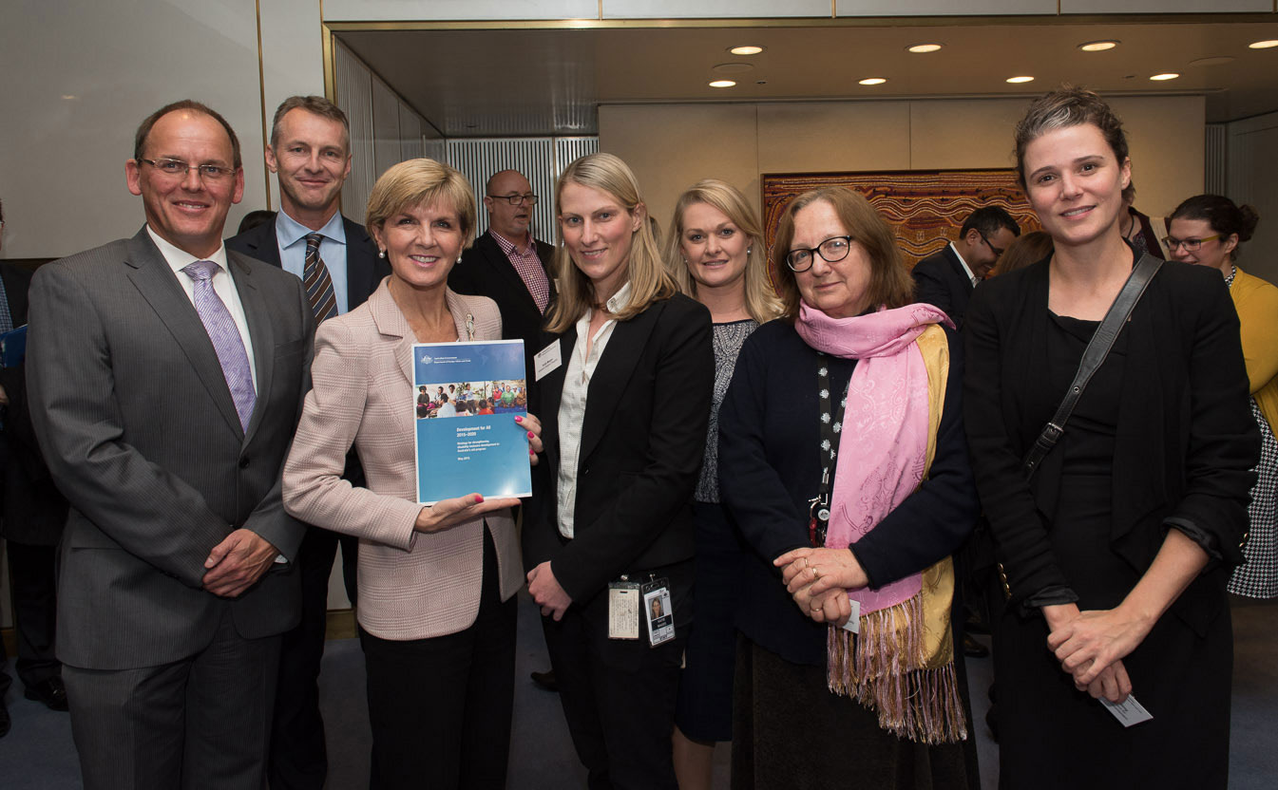
Evaluation of Australia’s Advocacy for disability-inclusive DEVELOPMENT
OFFICE OF DEVELOPMENT EFFECTIVENESS

Slide 2
Evaluation purpose
to assess the effectiveness of Australia’s advocacy for disability inclusion in development
Evaluation team: Laurie Dunn, Karen Ovington and Charlotte McClain Nhalpo

Slide 3
Plan for presentation
Difficulties in assessing advocacy
Evaluation approach
Evaluation methodology
Overall findings
Some specific findings
Conclusions

Slide 4
Difficulties in Assessing advocacy
Changing beliefs takes time
Targets have to be receptive
Effective advocacy is often multifaceted with many advocates
difficult to attribute outcomes to specific actions or a particular advocate
4. Changes in beliefs and attitudes are difficult to measure

Slide 5
Approach OF ODE EVALUTION
Limited scope to global advocacy
Covers both Development for All strategies
Analysis of contribution made by Australian advocacy (not attribution)
Developed a theory of change

Slide 8
Evaluation methodology
Document review
Interviews
Organisation | Number of interviews | Number of participants
DPO | 2 | 2
DFAT | 15 | 25
UN agency | 8 | 20
Organisations which focus on disability | 6 | 12
Other organisations | 3 | 4
Bilateral agencies | 2 | 2

Slide 9
3. Survey
Organisation | Number surveyed | Number of responses
UN agency | 12 | 7
DPOs | 2 | 2
Organisations with a focus on disability | 6 | 4
Other organisations | 6 | 6
Bilateral agencies | 16 | 12

Slide 10
Australia’s Credibility as an advocate
Factors that have contributed to credibility

Slide 11
Overall effectiveness of Australian advocacy
Factors that have contributed to effectiveness

Slide 12
Australia’s Leadership

Slide 13
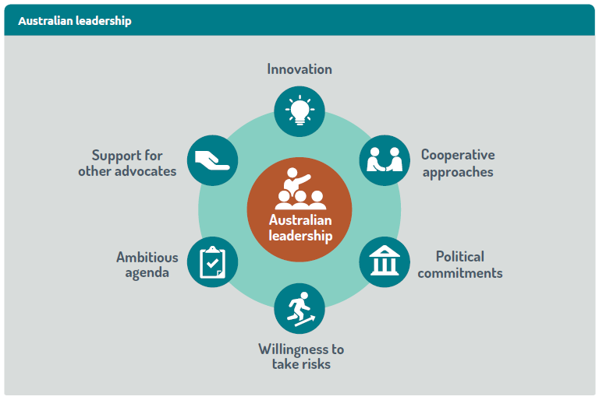
AUSTRALIAN LEADERSHIP

Slide 14
INFLUENCING Global POLICY processes:
2030 Agenda for Sustainable Development
Notes:
.

Slide 16
INFLUENCING Global POLICY processes:
World humanitarian summit

Slide 17
The Australian Government played a pivotal role in ensuring that disability inclusion was profiled throughout the World Humanitarian Summit process. We believe its advocacy …directly contributed to disability being included as a formal side event at the Global Consultation – a step which launched multi-stakeholder collaboration on the Charter on Inclusion of Persons with Disabilities — Humanitarian agency

Slide 18
Supporting other advocates: building DPO CAPACITY

Slide 19
Through DFAT support for DPOs our voices are now heard. We are changing policies, holding governments to account and lobbying for increased funding — DPO
Six years ago, IDA needed support. IDA is now well established and a key agency — UN agency
IDA has become one of the key strategic partners of most of the UN system ……and plays a key role in advocacy on the rights of persons with disabilities — UN agency

Slide 20
RECOMMENDATIONS
DFAT should : continue its global advocacy continue to support Australian leadership identify and use opportunities to advocate for disability inclusion in its operations act decisively and end funding to the Statistics Division of United Nations Department of Economic and Social Affairs

