Slide 1
Internews
Tweets, Texts and Social Change

Slide 2
Internews is an international non-profit organization whose mission is to empower local media and communication systems worldwide to give people the news and information they need, the ability to connect, and the means to make their voices heard.

Slide 3
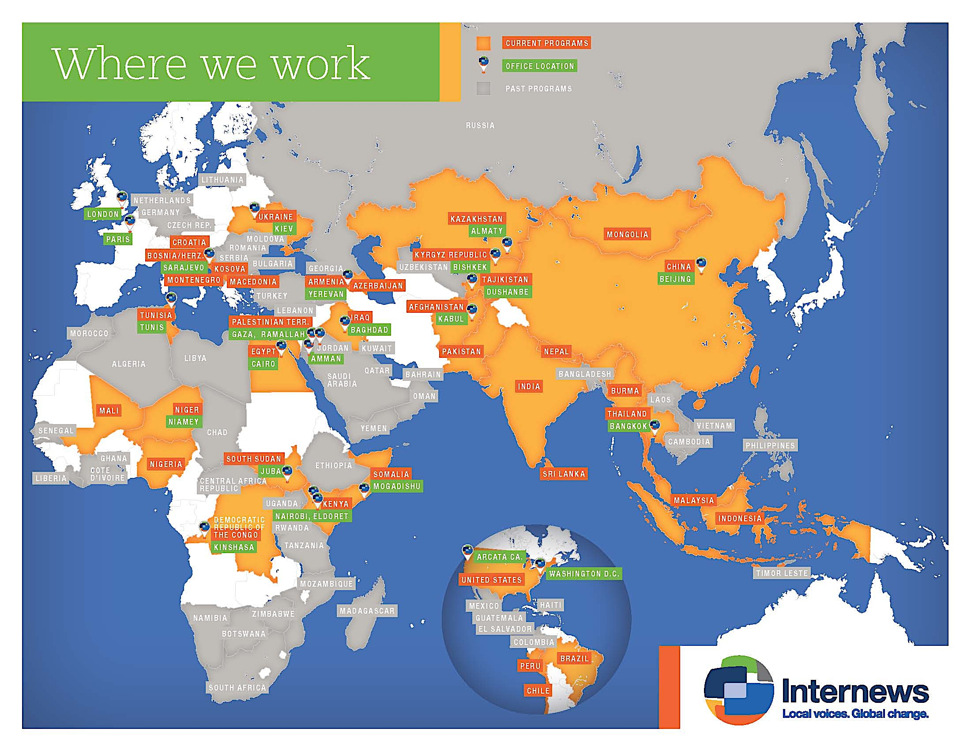
Notes:
2013: $60 million for the year (projected)
46 countries, offices in 24/25. 11 programs in Asia 650 employees, 100 in US. 60 in DC, 40 in CA. Majority of employees in AF and S. Sudan.

Slide 4
Case Studies:
Myanmar & Indonesia

Slide 5
Characteristics of ICT landscape in Asia
Explosive growth in Internet connectivity and mobile phone ownership
Lack of uniformity of ICT usage at sub-national level
Consumption of ICT not necessarily matched with corresponding levels of tech literacy

Slide 6
Challenges for ICT4D in Asia
Challenges
Approaches
Understanding a landscape which is rapidly evolving
Building programs which are scalable and replicable
Using ICT4D to reach populations in “media dark” areas.
Regulatory environment often does not keep pace with practice on the ground
Technology not a silver bullet
Use human centered design research to better understand user behaviors
Use approaches that combine online and offline
Pilot and iterate

Slide 7
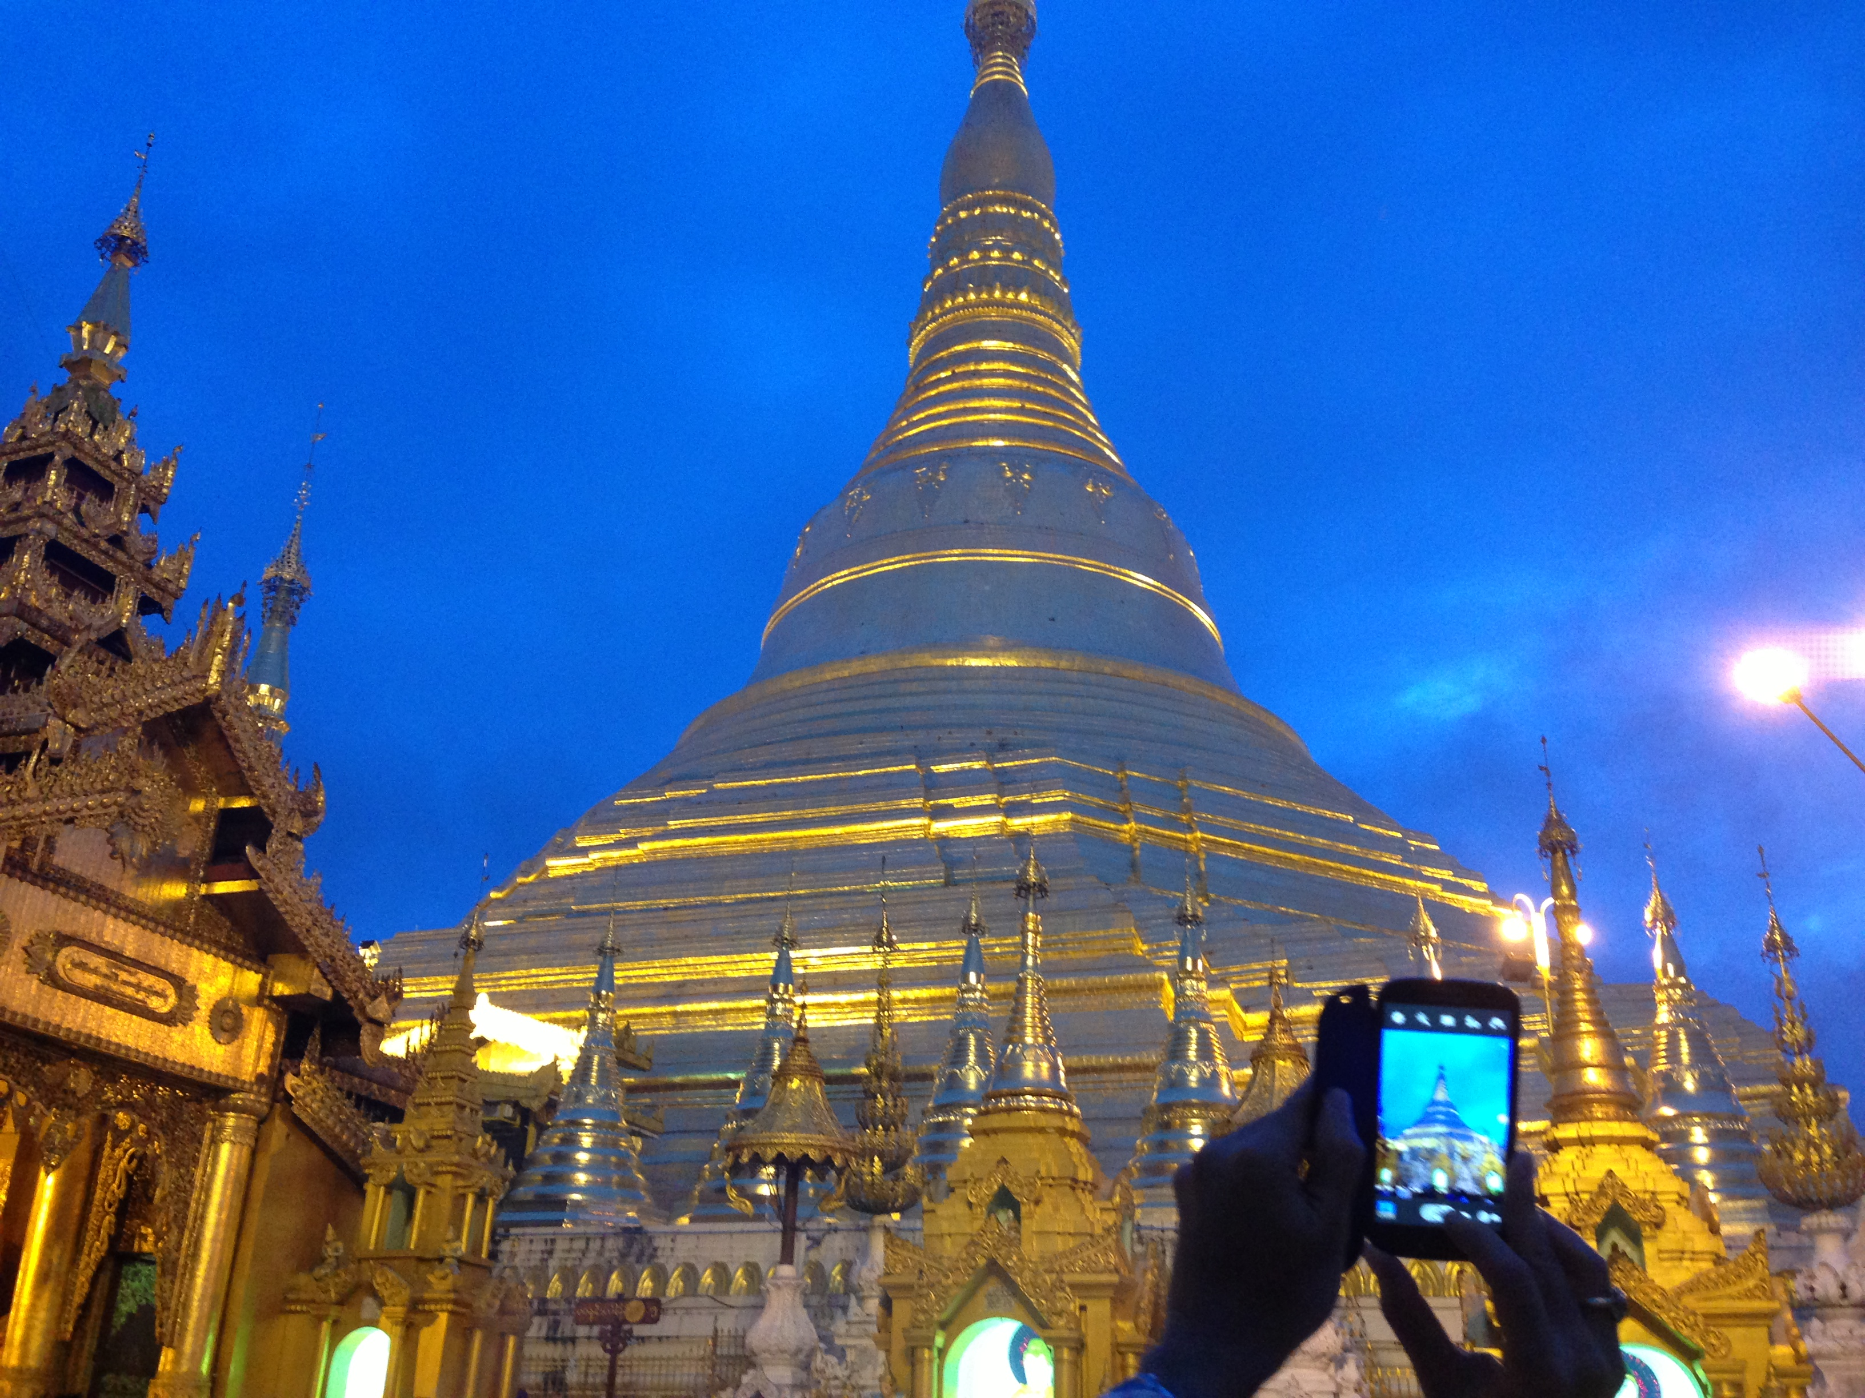
Myanmar

Slide 8
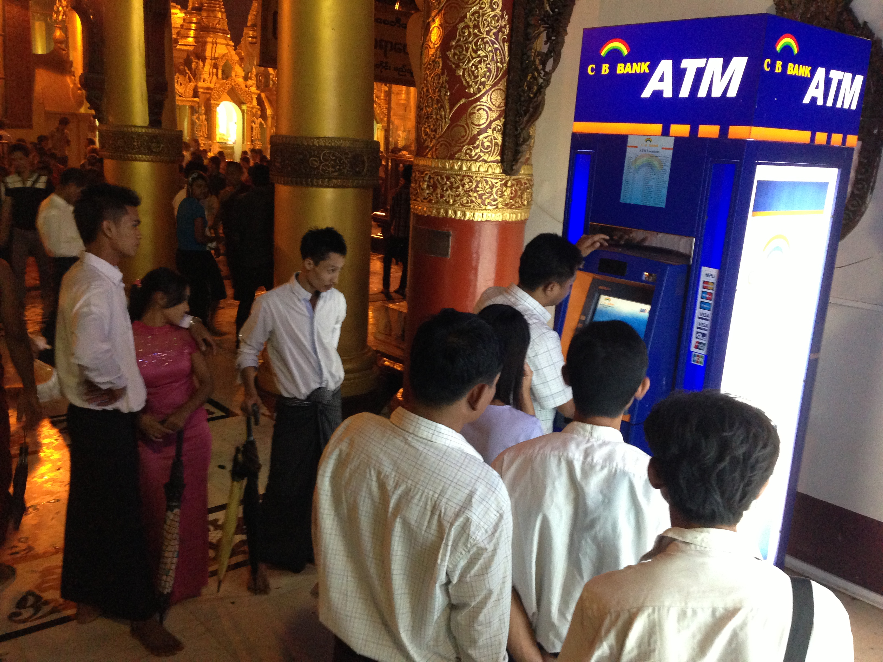
Myanmar at Present

Slide 9

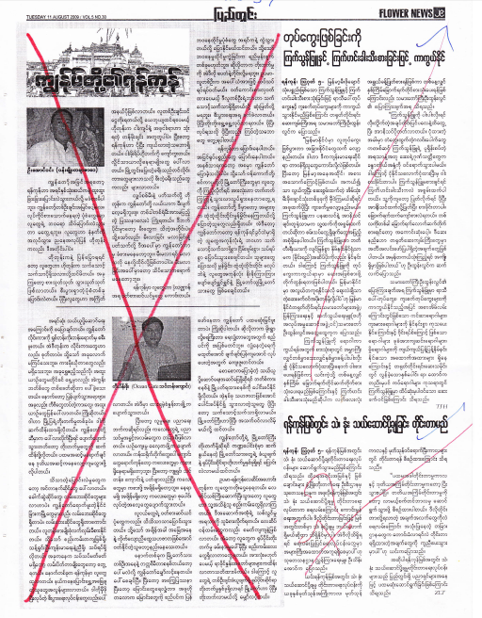
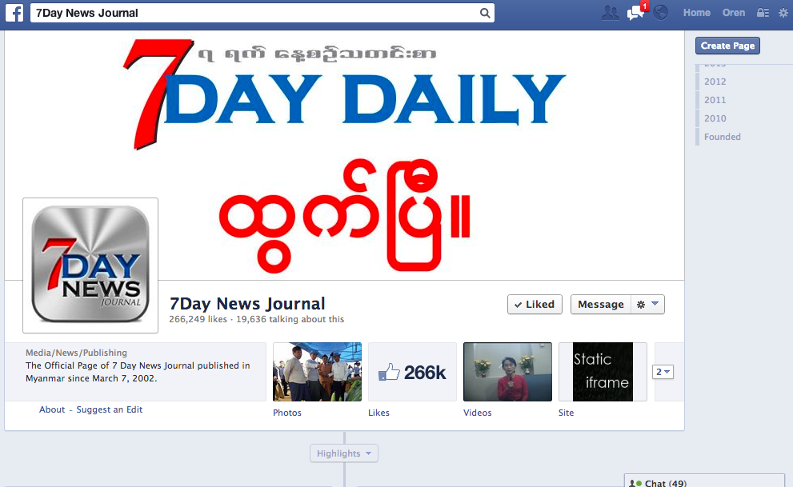
Disruptive power of new technology on information

Slide 10
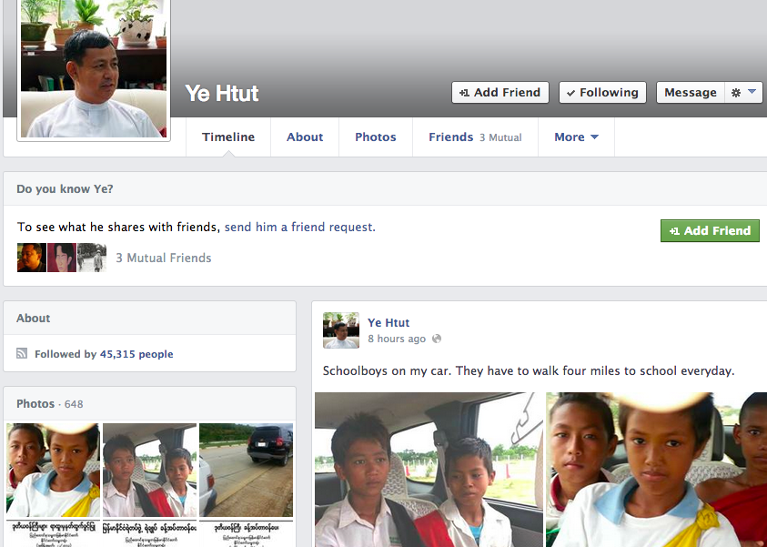
Impact on governance and transparency

Slide 11
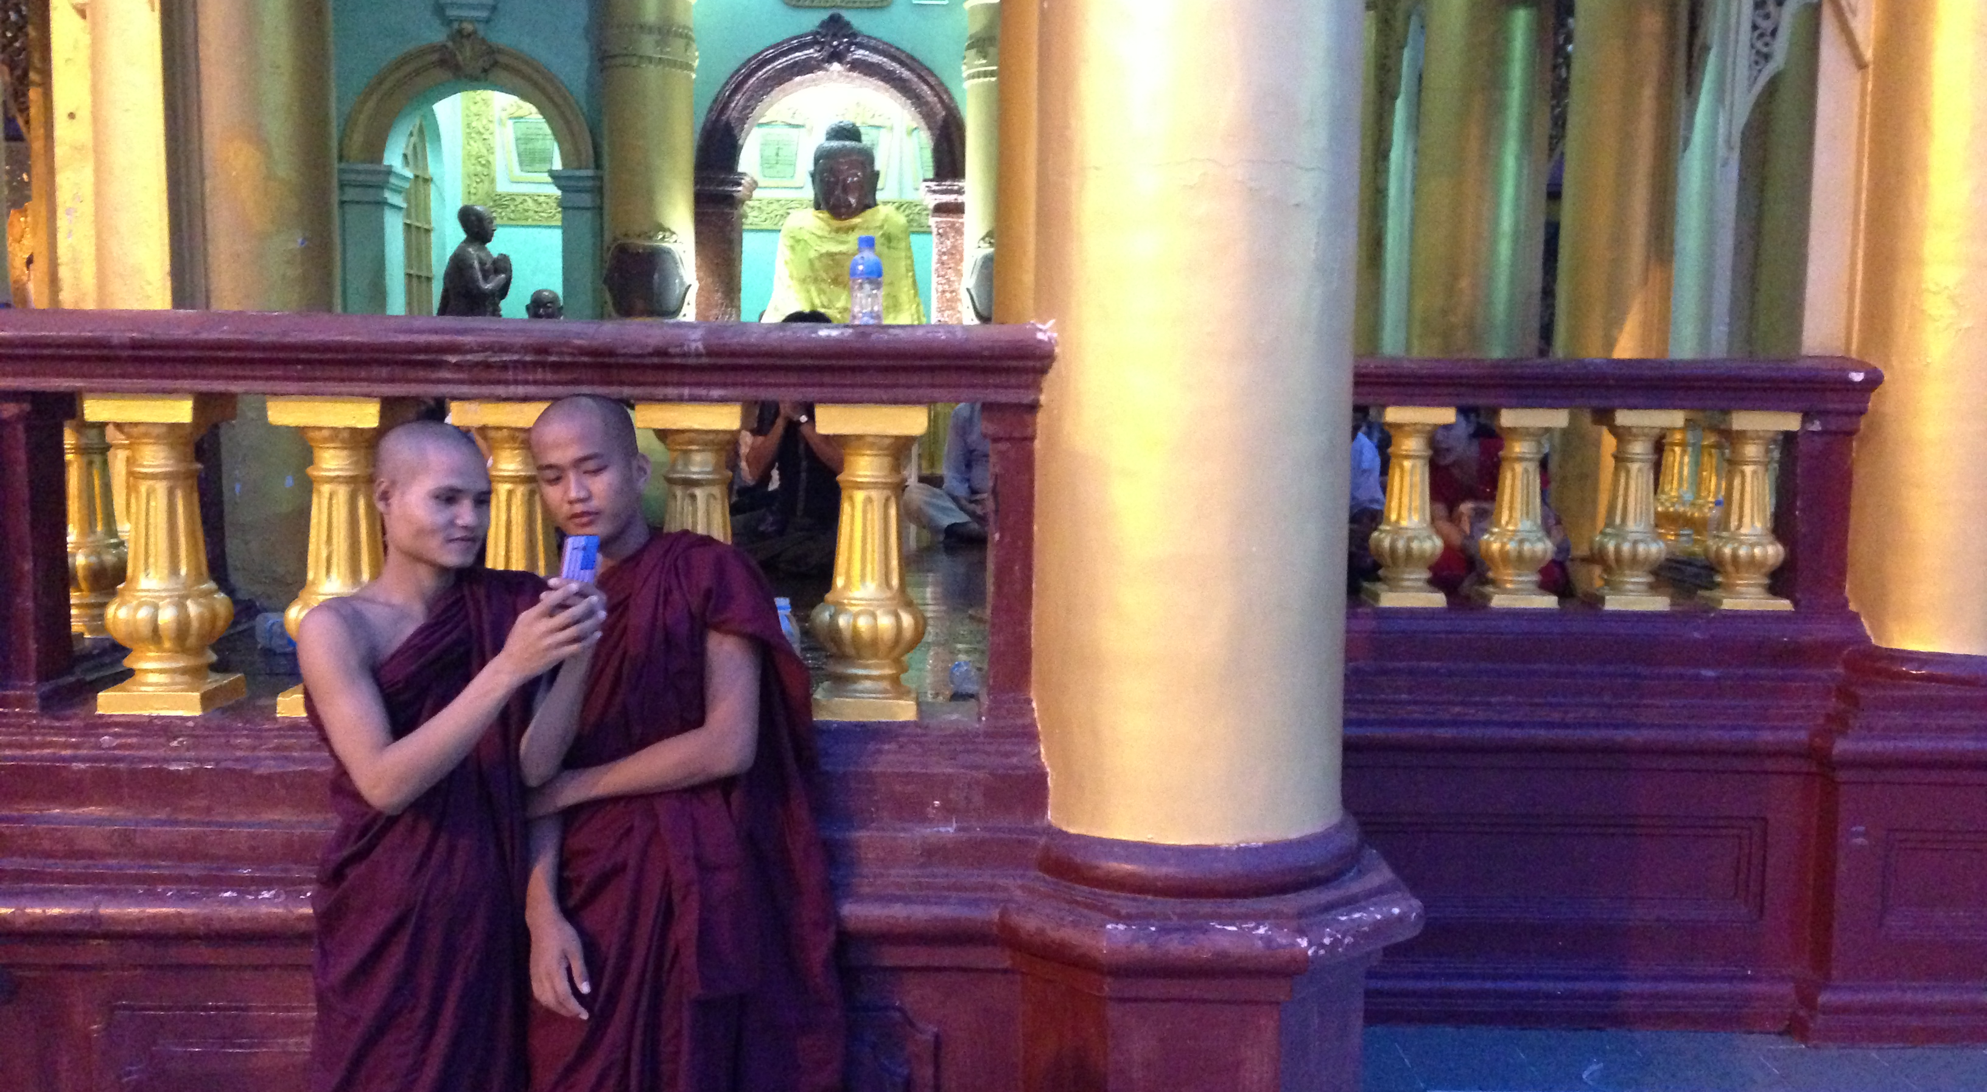

Slide 12
Indonesia: media and technology
The Next Decade

Slide 13

Indonesia: the numbers
  Online: 63 million or 25% (APJII 2012; 18% in 2010)
Twitter: 29 million (5th worldwide)
Facebook: 64 million, April 2013 (4th)
Mobile phone ownership: 107%
Notes:
There is some variation in these numbers depending on source, and other factors – e.g. lack of electricity access or mobile coverage – that lead to questions on comprehensiveness of coverage.

Slide 14
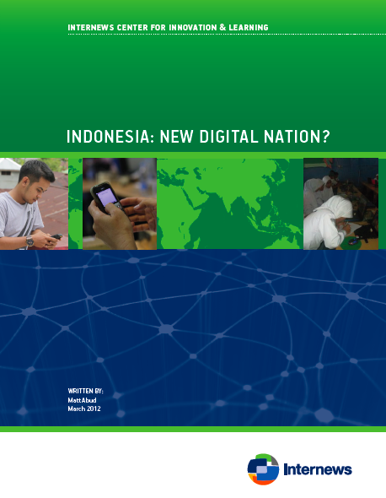
Online Mobilisation
  Urban middle class campaigns
  Coin for Prita, Bibit-Chandra
  Disaster response: mostly small, some high-impact
  (e.g. Jalin Merapi)
  Social cause campaigns limited (e.g. Lapindo)

Slide 15
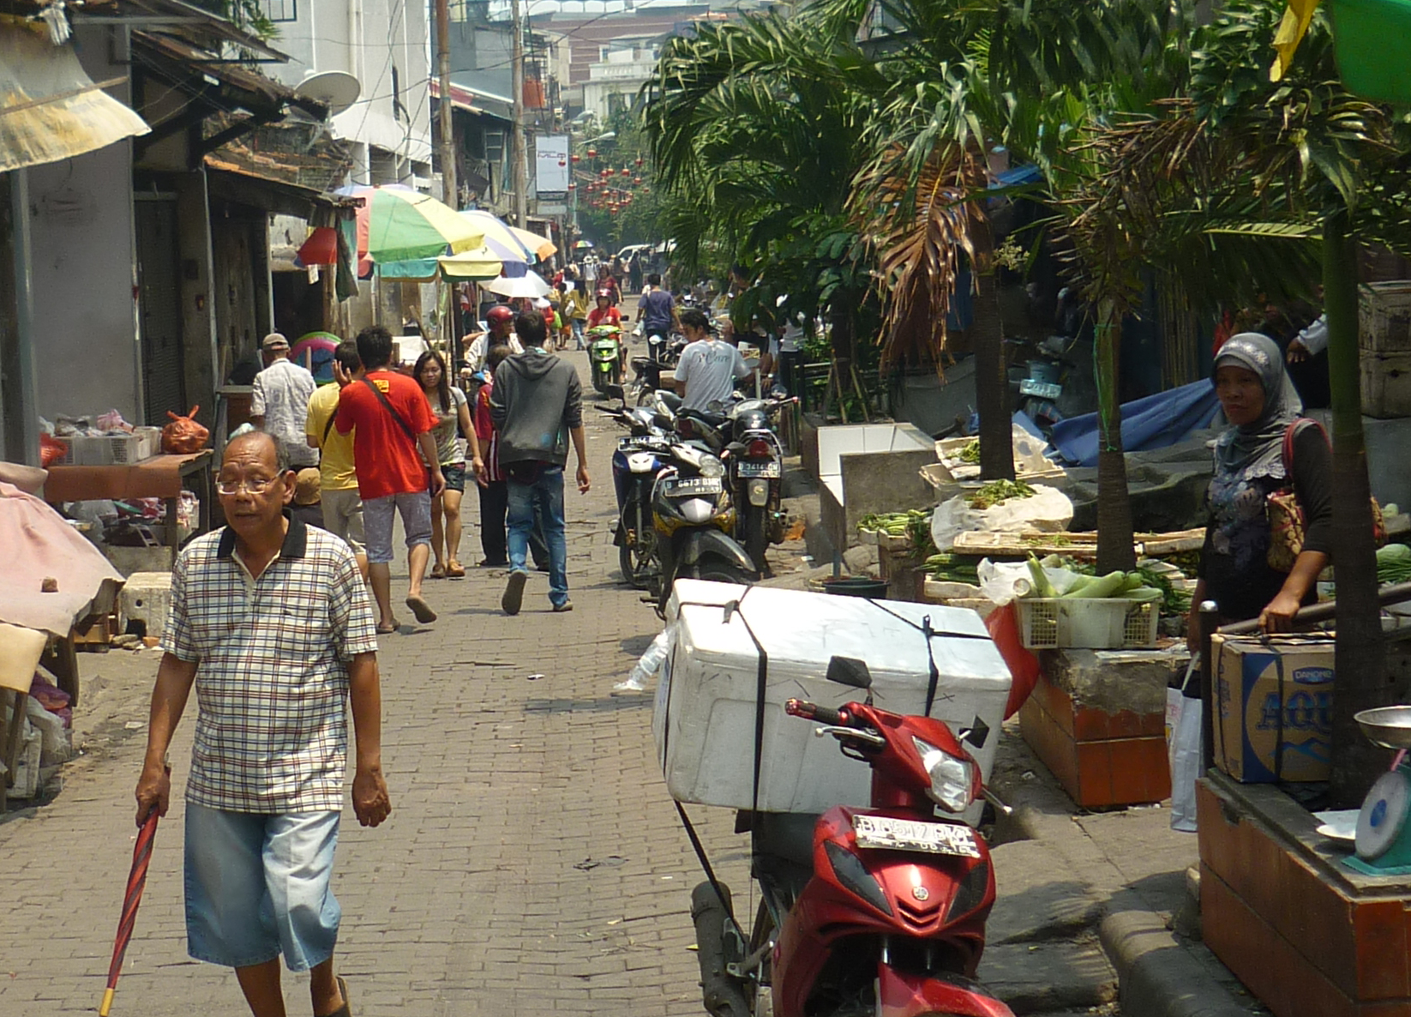
ICT and Social Practice
  Use vs. Literacy: Facebook
  New technology and disruption: cost, culture
  Online identities and practice: e.g. bloggers

Slide 16
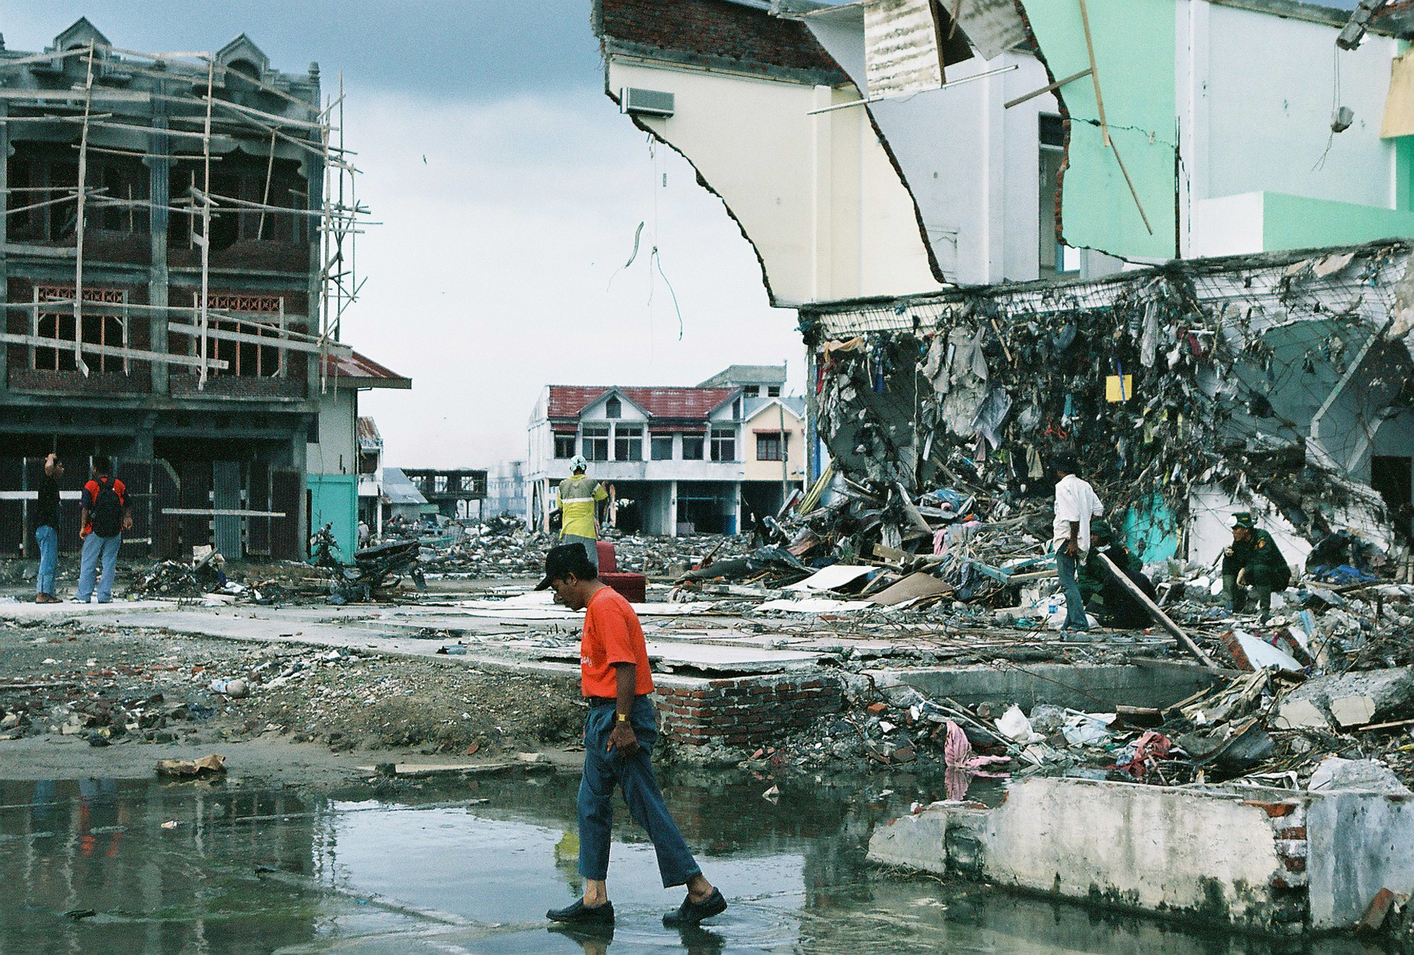
Crisis Communication ICT
  Jakarta floods:
  national tweets,
  local blackout
  Mobilisation, intervention:
  ODOS, UPC
  Resilience? Aceh, GSM, HT radio

Slide 17
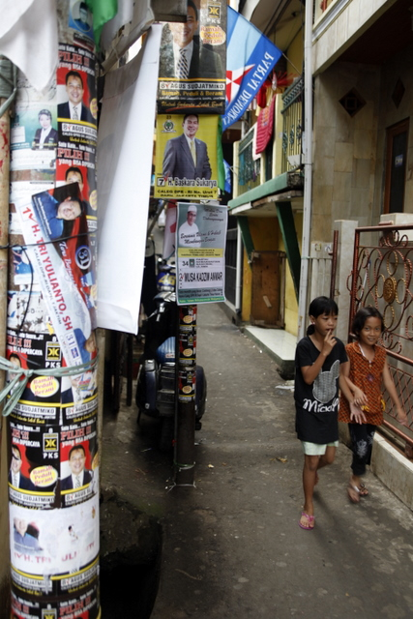
Campaigns & Media
  FB campaigning: personal. Jokowi, Ahok; YouTube
  Media dissemination, CJ. Kompasiana, Detik.com, etc.

Slide 18
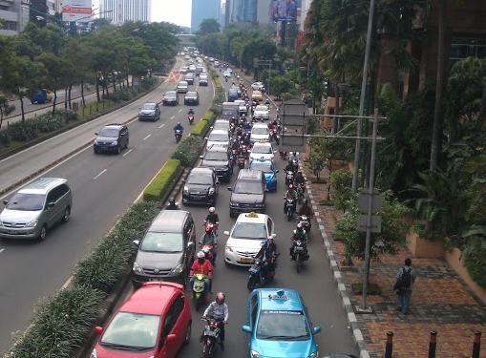
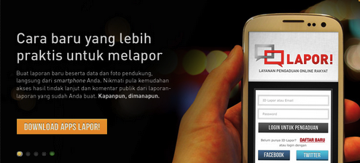
Governance
  Open Government Partnership
  e-procurement, Open Schools, Open Budget
  Local government ‘Information Shock’

Slide 19
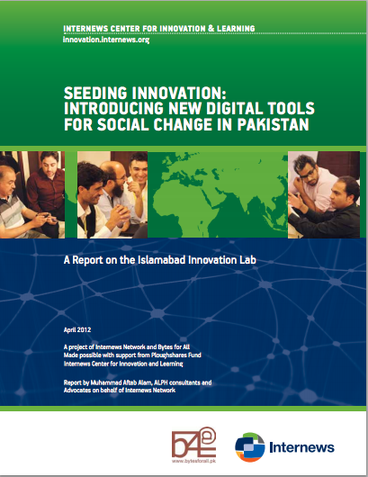


Better Digital Bridges: Pilots & Practice
  Innovation Labs: Pakistan, Afghanistan, etc.
  Developer-civil society-media relationships
Notes:
Islamabad Innovation Lab:
Mahafizz: Challenges for Rights defenders in tribal areas
Bus Karo: reporting domestic violence
Khoon say Zindagi: community blood bank database
Mera Vote Meri Taqat facebook page
Mother Child Health Karak (SMS access health care)
RYSe Reclaim your space sexual violence reporting
Dysaster.org
Afghan Innovation Lab (some):
Violence against women
Polio tracking
Election reporting
Traffic monitoring
Hajj registration …etc
Our Innovation Lab models are a great way to introduce ICTs for development to civil society or even local govt staff/leaders who are traditionally not familiar with the stuff. Also, the Lab model is a great way to introduce technical people, developments or the IT industry to working with civil society and government… It breaks down barriers.

Slide 20
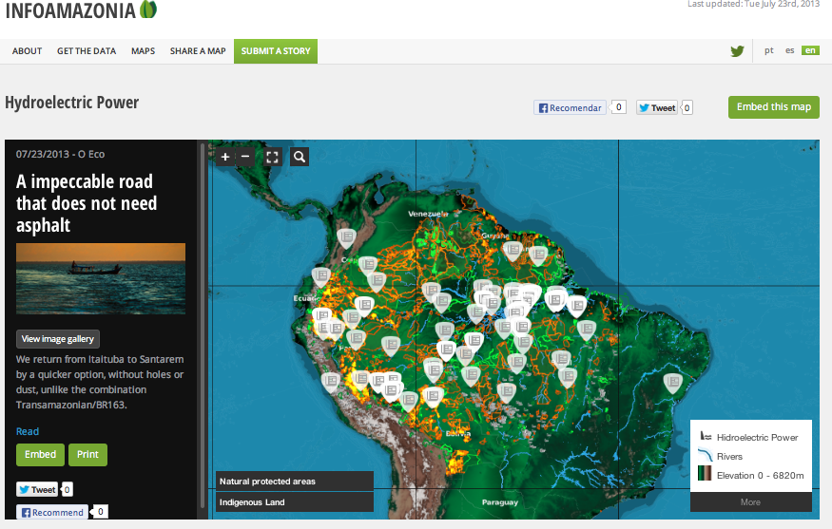
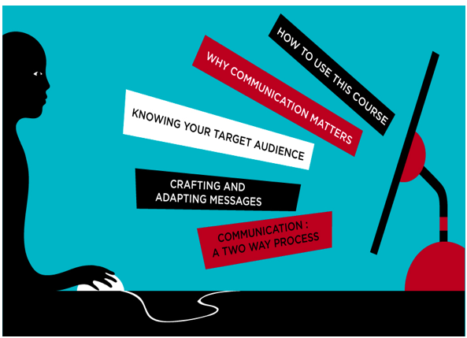
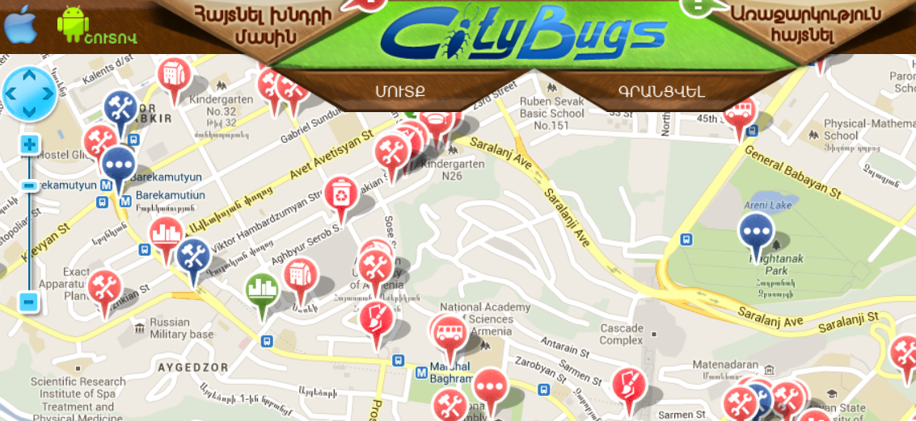
Better Digital Bridges: Pilots & Practice
Notes:
Infoamazonia
Infoasaid e-Learning http://infoasaid.org/e-learning/course/start
Armenia, local government
Other possible examples: mapping for religious tolerance in Malaysia
Games for women’s rights (Malaysia)
Land violations (Ghana?)
Community resources against slavery (where? Not Ghana again?)
Wannakonnect, income for radio stations (Kenya?)
Journalist security mapping, Afghanistan
Elections…something…
We learnt from the West Kalimantan pilot, that when interactive systems like SMS or IVR is used at a hyper-local or very local level, where there's local curation - there's positive outcome
E-Learning - our infoasaid program has created a free e-learning course 'Communication is Aid' http://infoasaid.org/e-learning/course/star
Internews approach: Effective Use of ICTs
Build links and collaborations between digital developers, government, community workers / NGOs, local communities, business. ICT needs to become mainstream.
Community development, institutional development etc. principles remain central
Understand key influences: private and public infrastructure investment, education, free speech and related laws, political discourse
---
General thoughts / notes towards questions…
Ways forward
Integrate within programs and institutions, but keep flexible to adapt and learn (tricky!)
Universities, schools, targeted online coding courses (Codecademy, etc.)
Public use and awareness
Policy and advocacy
illustration of how these things fit together: Langit 7 and mobile applications. Lack developers because of competition from Samsung (skill levels). Also can’t get data quickly enough because of bottlenecks in key government institutions’ data management (institutional capacity). Can’t use Google Maps because of the charges for high use, from Google’s business model (market influence). But OSM less well-known, needs crowdmapping input to work (civil society, volunteers needed). Consumers on feature phones, not using apps (citizen understanding and practice)– can use mobile websites but they strain with limited capacity in periods of high demand and can’t use ‘push’ technology (infrastructure). Fix any one of those things and change is possible.

Slide 21

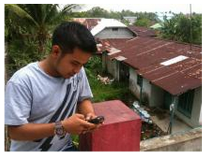
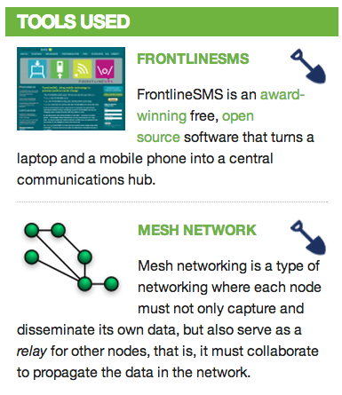
Indonesia and ICT4D
Notes:
Research, pilots, projects. Latest Internews activities in Indonesia.

Slide 22
For more details contact:
Oren Murphy – Regional Director Asia omurphy@internews.org

