Slide 1

Road Management in Papua New Guinea: An evaluation of a decade of Australian support 2007–2017
OFFICE OF DEVELOPMENT EFFECTIVENESS
Presenter: David Slattery, Director ODE
Evaluation team: David Slattery (team leader); John Lee, Independent Consultant; and Matthew Dornan, Deputy Director Development Policy Centre, Australian National University.

Slide 2
Plan for presentation
About TSSP
About the evaluation
Context
Findings

Slide 3
About TSSP
Long-term effort.
Spending close to three quarters of a billion dollars
Focus on all transport, including maritime and air, but majority of funding on land transport
Land transport focus = national roads
Key partners = Departments of Transport and Works

Slide 4
About the Evaluation
Scope
Resources
Method

Slide 5
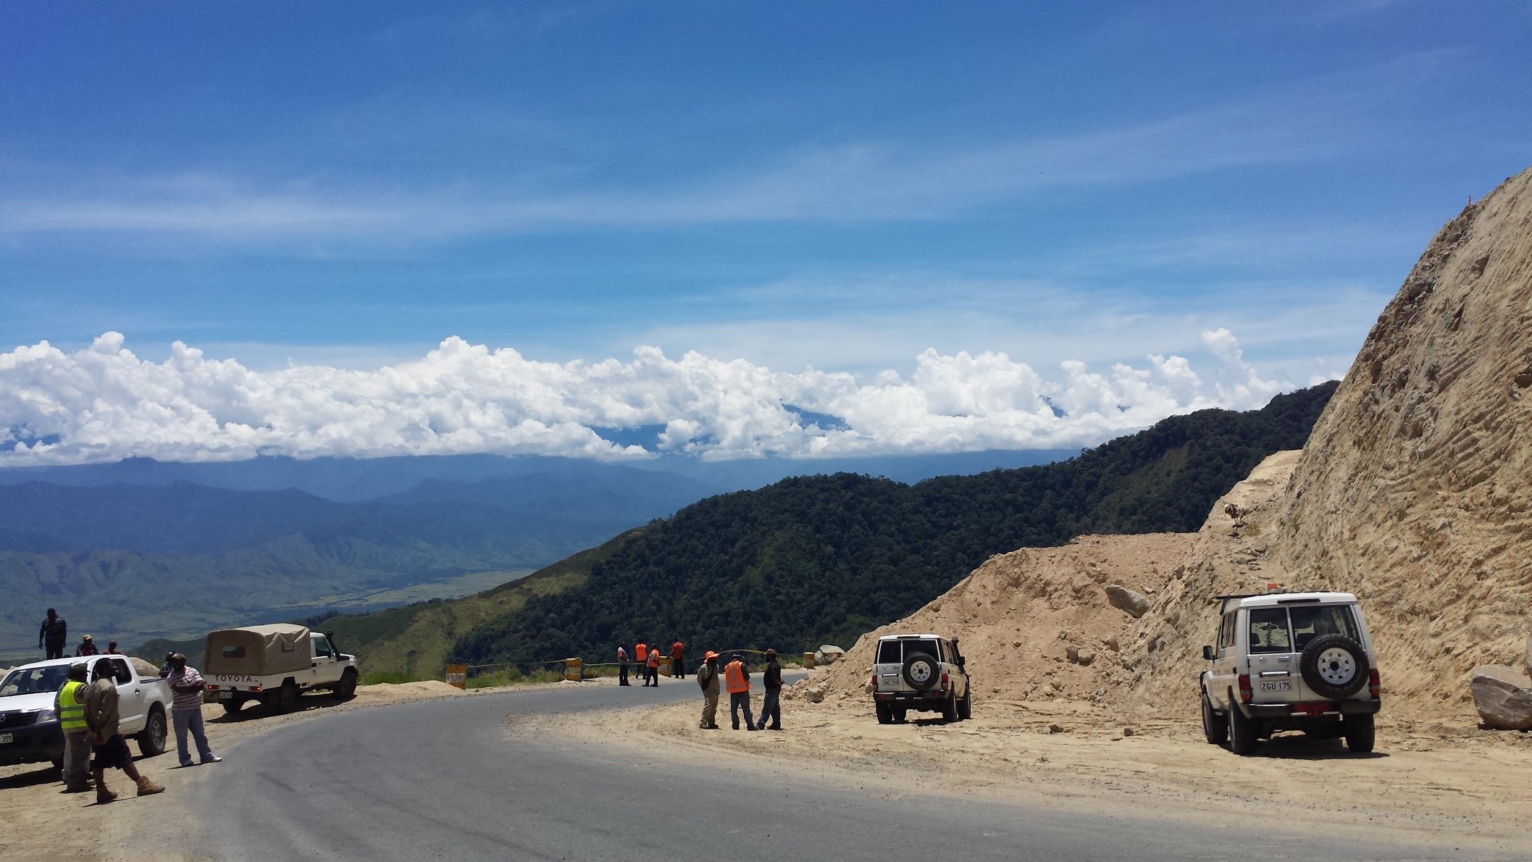
Context

Slide 6
PNG Government expenditure and revenue, real (2015) Kina, millions

Slide 7
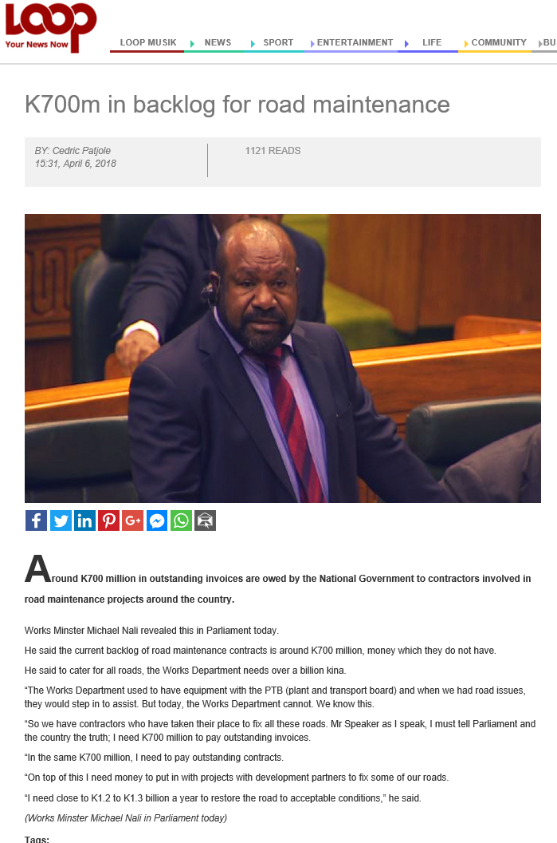

Slide 8
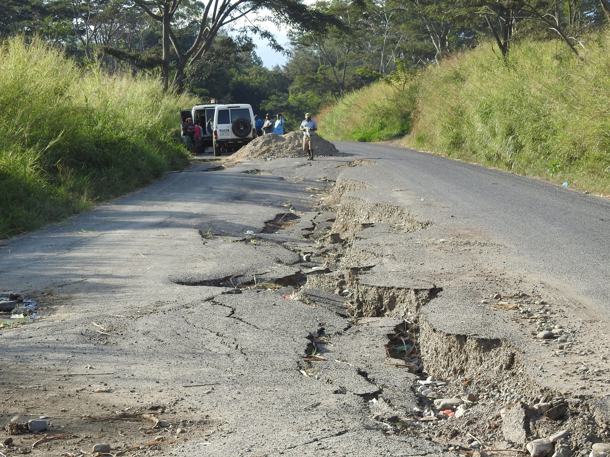

Slide 9


Slide 10
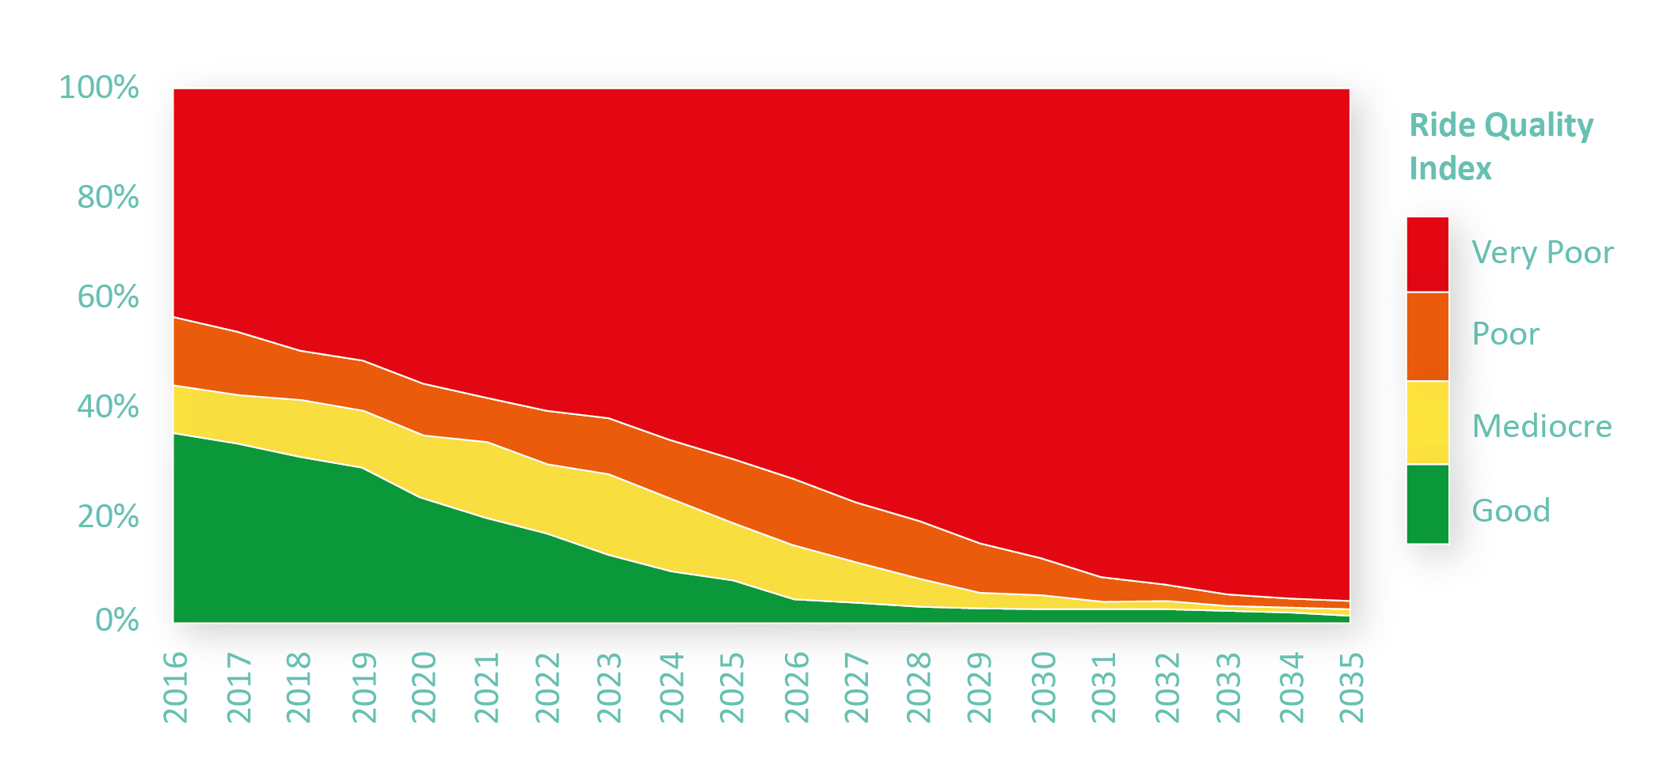
Predicted condition of priority sealed roads with continuation of current funding levels

Slide 11
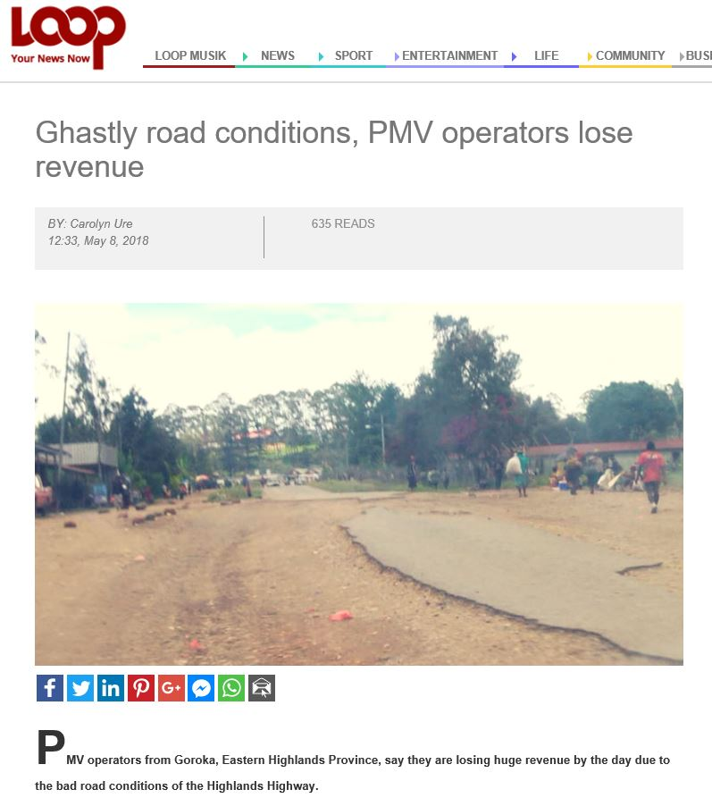

Slide 12
OVERALL FINDINGS
Focus on maintenance ✓
Focus on national priority roads ✓
Direct benefits through physical works ✓
Influence on sector policies ✓
Brings capacity to the sector ✓

Slide 13
challenges
Influencing budget outcome
Sustaining capacity building outcomes
Providing predictable funding

Slide 14
SELECTED Areas for improvement
Policy dialogue
Information on land transport spending
Information on road conditions and trends

