Slide 1
Service Characteristics and Regulatory Oversight of Public Transport in Port Moresby,
Papua New Guinea
Oliver Page, Ph.D., Jack Assa, M.Si, & Elton Powe, BSc
2018 PNG Update Conference
“PNG in the Year of APEC”
14-15 June 2018
Port Moresby, PNG
Notes:
Opening slide. You don’t have to spend anytime on this one.

Slide 2
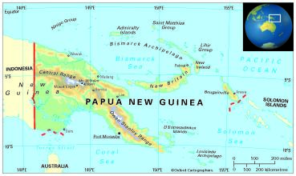
Introduction
Papua New Guinea (PNG)(Population ~8 million)
Port Moresby capital city of PNG
364,125 persons, approximately 5 percent of PNG’s total population of 7.25 million (2011)
240km² (~ 93 square miles) approximate land area
20 planned settlements, 79 informal settlements and 7 urban villages (2013)
Study objective to identify public transport service characteristics and regulatory framework in the rapidly growing city of Port Moresby
Notes:
Just mention a few key bullet points
Slide gives overall background to PNG, PNG and study objective

Slide 3
Characteristic #1: Historical Timeline of Public Transport
1960s+ | PMVs (privately owned) operate anywhere and anytime in Port Moresby Port Moresby Bus Company (government owned) competed with PMVs
1968 | Establishment of the National Land Transport Board (NTLB)
1973 | Operating licences issued to Indigenous Papuans
1981 | Port Moresby Bus Company liquidated
1987 | NTLB licenses PMVs to operate on specific routes
1997 | Establishment of National Road Safety Council (NRSC)
2002 | Establishment of Independent Consumer and Competition Commission (ICCC)
2014 | UN Women PNG investigate public transport safety of Women and Girls Road Traffic Act passed
2015 | “Meri Seif Bus” (Women only) commences operations in Port Moresby
2016 | Establishment of the Road Traffic Authority (RTA)
2017 | RTA -Transport Act passed (Various Acts Amended)
2018 | June (1st) New Regulations and Rules comes into play
Notes:
Just mention a few key bullet points (don’t spend too much time on this slide)
You could mention that there was a time when government owned public transport played a big role but that stopped with the liquidation of the Port Moresby Bus Company in 1981
In the past the majority of public transport was owned and operated by non PNGs

Slide 4
Characteristic #2: Vehicle Type, Population and Permits
Type | Capacity/ Seats (including operator’s seat) | Routes | Official Number of Registered Vehicles (2015) | Ownership | Notes
Coaster Bus (Toyota) | 25 | Intra-urban routes within the city | 800 | Private | In addition, there are an unknown number of unregistered PMVs
Minibus | 15 | Inter-urban Routes to/from outside of the city | To be determined | Private
Taxi | 5 | Intra-urban routes within the city | 970 | Private
Comeng/Volvo (Conventional Bus) | 44 | Intra-urban routes within the city | 6 | Ginigoada Bisnis Development Foundation (Nonprofit) | Meri Seif Bus (UN Women owned and operated by NCDC: Only for women)
Ashok Leyland (Conventional Bus) | 50 | Intra-urban routes within the city | 19 | Public | Owned and operated by the NCDC
Notes:
You researched the figures for this table so it should be easy to relate to others
You could be asked a question when and where are the NCDC buses used, i.e., do they operate on regular schedules and routes. I think the answer is no but you could verify.

Slide 5
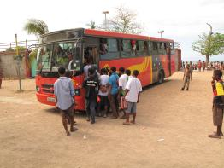
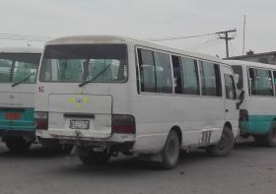
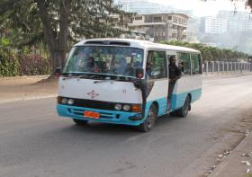
Characteristic #2: Vehicle Type, Population and Permits
Route permit required to operate on any PMV route
Route permits valid for six (6) months
Route Permits issued to the PMV or Taxi owner by NLTB/Road Traffic Authority (RTA)
PMV ceiling for any route is 60 permits (irrespective of passenger demand)
Notes:
This slide is straightforward
Permits are not issued reflective of route passenger demand but quantitatively limited.. That is why if a ceiling is reach a PMV operator get a permit for a route with capacity and then operates on a profitable route. This point is important as passenger demand along a route should drive permit issue
The lack of enforcement of permit allocation and operation has facilitated abuse of permits by PMV operators

Slide 6
Characteristic #3: Port Moresby PMV & Meri Seif Route Network (Active)
Notes:
You may have to explain why two routes have the same number? Has the route been divided? What agency did this or was is done soley by the PMV operators?
State the number of unserved routes?
Where are they unserved routes?
State that there are 3 women only (Meri Seif’) bus routes operated by UN women/Ginigoada Bisnis Development Foundation

Slide 7
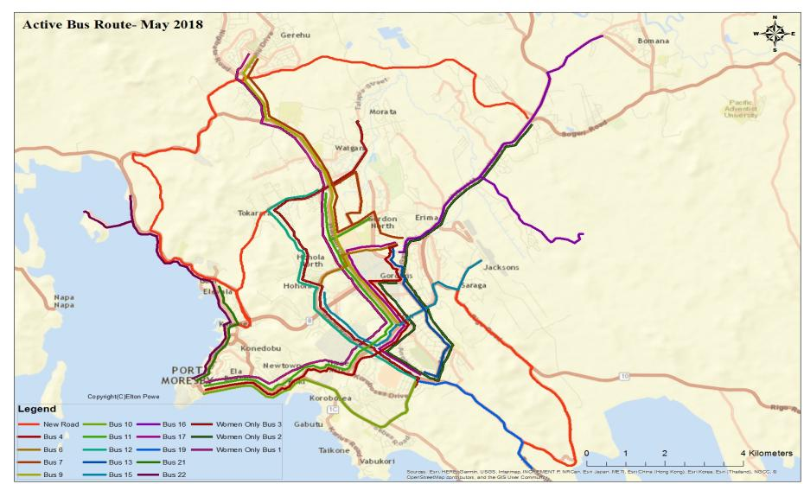

Slide 8
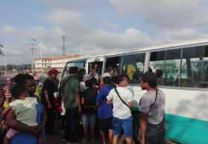
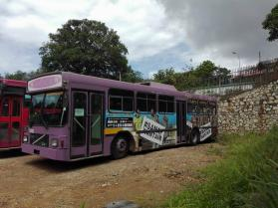
Characteristic #4: Women Unfriendly
In 2014 82% female PMV users felt unsafe while waiting for PMVs and 79% riding in them (UN Women PNG)
PMVs stops at or near markets were known hot spots of sexual violence or sexual harassment
Female market vendors travelling after dusk are forced to use taxis to return home
Walking further distances than necessary places women and girls’ in a vulnerable position to experience unwanted sexual violence or harassment
Notes:
UN Women PNG has investigated the challenges women and girls face when using public transport in Port Moresby
UN Women PNG primary sponsor for Meri Seif women only buses

Slide 9
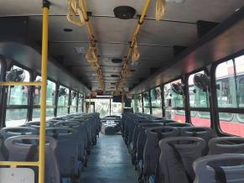
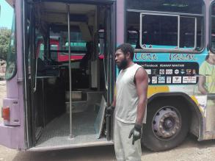
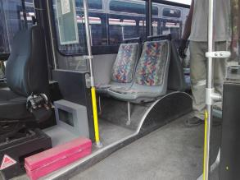
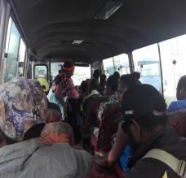
Characteristic #5: Disabled Unfriendly
Multiple steps to board/alight from vehicle
Overloaded PMVs especially during peak times
Lack of priority or preferential seating
Narrow aisles in conventional buses & PMVs
Some boarding locations impossible to reach during rainy season
Notes:
You could mention exploratory study of disabled persons and use of public transport in Port Moresby by Page & Assa in 2017 (article under review at potential publisher)
You know what to say as you took the photos and did the research. Great work!!!

Slide 10
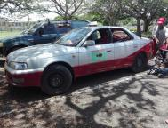
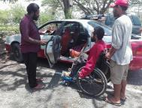
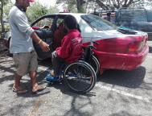
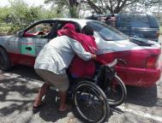
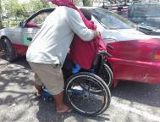
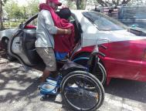
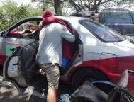
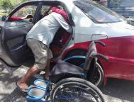
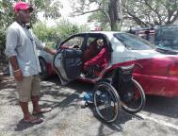
Characteristic #5: Disabled Unfriendly
Private taxis used if funds available
Some taxi operators charge disabled riders more to recoup lost revenue
No taxis or PMVs are disabled friendly
Shared taxis often do not stop for disabled person
1
2
3
4
5
6
7
8
9
Notes:
This image tries to show one challenge that a disabled person faces when using public transport
The disabled person may experience low self esteem, apprehension and personal indignity when using public transport. This point is important to get across Jack.
This image may bring home the reality of using public transport while disabled to the audience

Slide 11
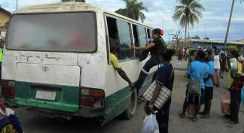
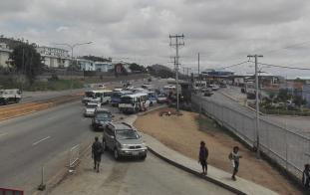
Characteristic #6: Traffic Safety and Vehicle Maintenance
Typical PMV Operating Conditions:
  Overloaded and unroadworthy vehicles
  High crash rates
  Multiple and persistent violations of traffic safety regulations
  Wilfully dangerous operation of vehicles
Accident/Traffic Crash factors:
  Drunk driving
  Inadequate road safety awareness by drivers and pedestrians
  Absence of uniform traffic engineering standards
  Accident blackspots
  Inadequate enforcement of traffic rules
Notes:
Point out the women getting into the PMV via the window
Point out the PMVs blocking the highway
This slide is straightforward as all PNGs in the audience will know about at least one of the issues mentioned

Slide 12
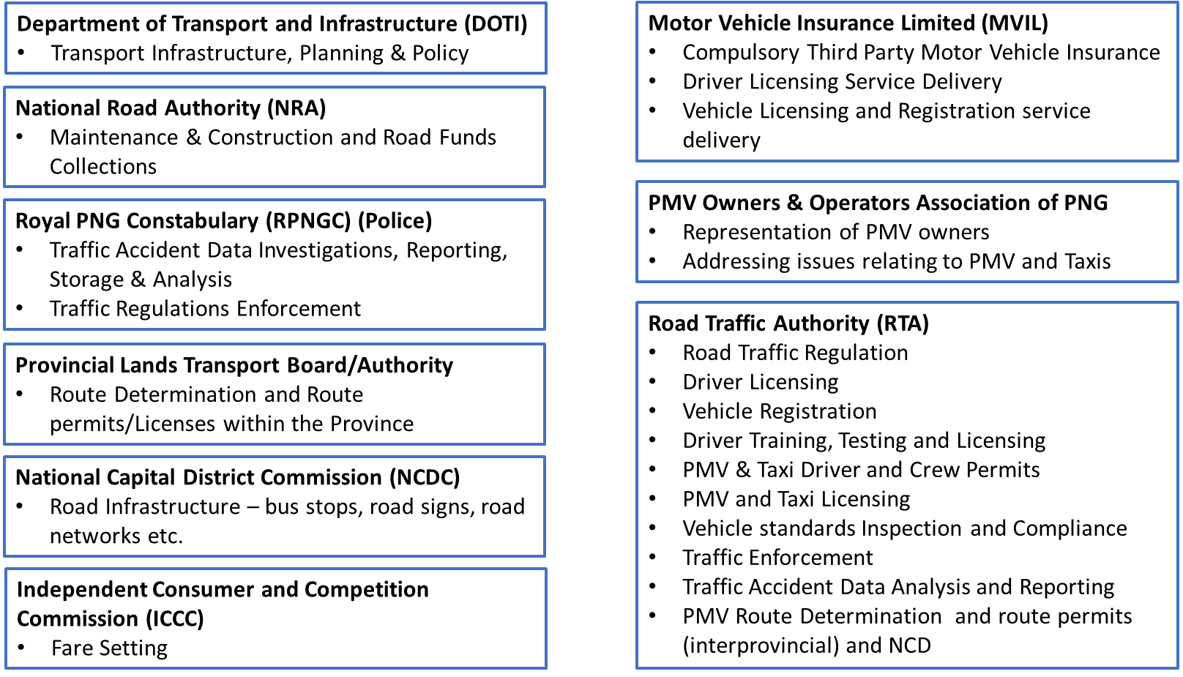
Regulatory Framework & Stakeholders
Notes:
Nine regulatory players in public transport operations in Port Moresby
Pick two or three agencies to highlight agency and functions

Slide 13

Regulatory Framework & Road Traffic Authority
RTA established in 2016
  Proposed agency described in Medium Term Transport Plan 2013
  Streamline fragmented transport regulatory system
  Address inefficiencies in transport operations, regulations and enforcement
  Consolidate functions of Land Transport Division (LTD), the Land Transport Board (LTB) and the National Road Safety Council (NRSC)
RTA primary public transport regulator in the NCD/Port Moresby
  Determine Routes
  Issue Permits
  Vehicle Registration
  Drivers Licensing
  Transport Licensing
  Traffic Enforcement
  Vehicle Inspection & Compliance
Notes:
I’ve tried to give some reasons for the creation the RTA
What benefits will the RTA bring?
You can relate what you learnt from the meetings with Wilson

Slide 14
What have we learnt?
Route needs identification and PMV route permitting has failed to keep up with demand
Lack of PMV route enforcement leaves many passenger groups underserved and inconvenienced
Fragmented regulatory system and limited enforcement of existing rules has contributed to an inadequate PMV and taxi system
Women, girls and the disabled are underserved users of public transport
Consolidation of functions within the RTA together with sustainable financing has the potential to significantly improve public transport operations in NCD
Notes:
You should be able to relate to all the points made on this slide and put across to the audience

Slide 15

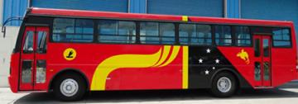
Recommendations
Establishment of an Advocacy Group for PWD public transport users
Revisit the design of public transport infrastructure, facilities and PMV operating practices that includes all users (women, girls, elderly and disabled)
Continued consolidation of permit issue, route needs identification, regulatory oversight, etc., with the RTA
Identify low cost interventions to increase route capacity with existing PMVs
Notes:
You should be able to relate to all the points made on this slide and put across to the audience

Slide 16



Acknowledgements
Thank You/Tenkyu
Any Questions?
Wilson Wariaka, MT (Civil), BE (Civil), MIEPNG, Reg. Eng
Road Traffic Authority (Papua New Guinea)
National Road Traffic Authority (NRTA)
Cheshire disAbility Services
Participants of Focus Groups and Key Informants
UN Women Papua New Guinea
Oliver Page, Ph.D.
U.S.A.
o.a.page@gmail.com
Jack Assa, M.Si
Papua New Guinea
jackassa945@gmail.com
Elton Powe, BSc
Papua New Guinea
eltonpowe@gmail.com

