Slide 1
The 2018 earthquake in Papua New Guinea: were lessons learned from the 2015-16 drought?
Brendan Jinks and Mike Bourke
Australian National University
PNG Update, Port Moresby 14 June 2018

Slide 2
Why?
Unique opportunity to explore two different disasters that occurred three years apart
Same national government and staff
Slow onset vs sudden onset
Methods
Post Courier, National, ABC and other media
Facebook and social media
Press releases, situation reports
Interviews

Slide 3
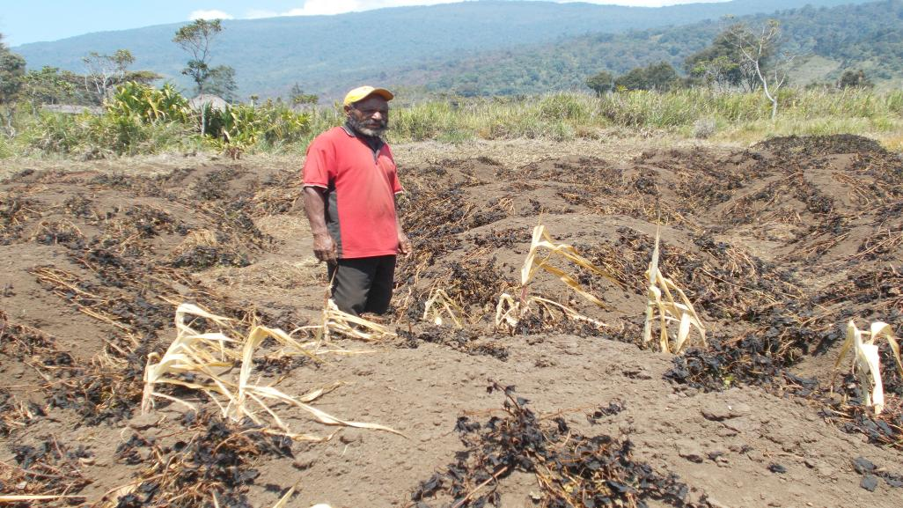

Slide 4


Slide 5
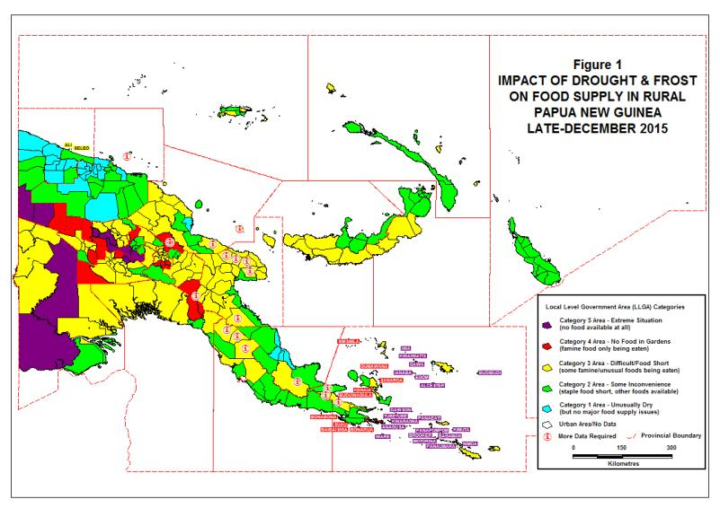

Slide 6
Drought snapshot
18 months duration (mid 2015 to late 2016)
Frost in high altitude areas destroyed crops
Major impact on water and food supply
Major impacts in Western Province, high altitude Hela and Enga, and Milne Bay Province
770,000 people faced food shortages
Thousands of deaths
Many schools and health centres closed
Long term impact on children

Slide 7
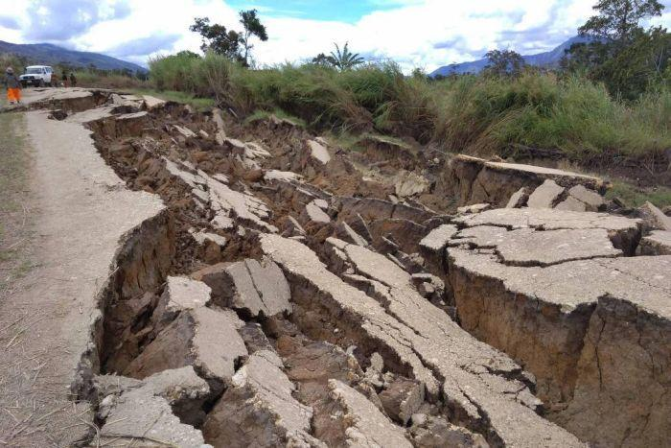

Slide 8
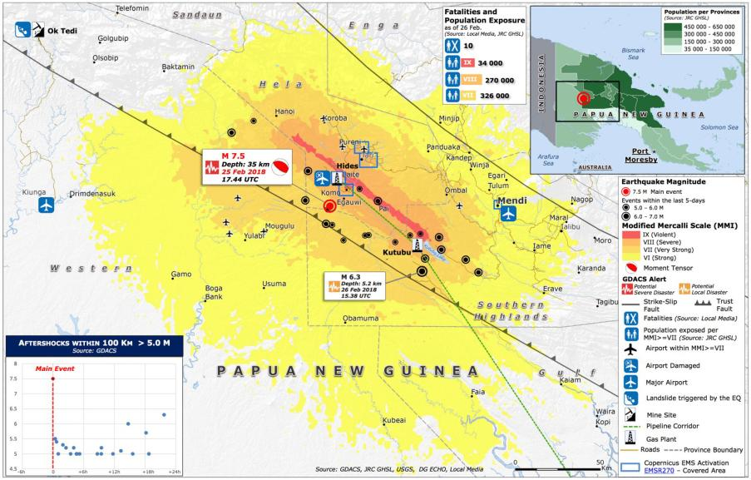

Slide 9
Earthquake snapshot
7.5 magnitude earthquake struck Hela Province
Affected Hela, SHP, Enga, East Sepik and Western
Many homes destroyed, many people displaced
150,000 people seriously affected
Water and food shortages
Economic impacts as PNG LNG and Oil Search closed down
Destruction of roads and telecommunications

Slide 10
Comparing the impacts
Parameter | 2015-16 Drought | 2018 earthquake
Timing/duration of impact | Mid 2015 to late 2016 (18 months) | 26 February to late May 2018 (3 months)
Total people seriously affected | 770,000 | 150,000
Deaths | 1,000s | 150
Food shortage | Major for many people | Major for some people
Water shortages | Major for many people | Major for some people
Displacement | Major for some people | Major for some people
Economic loss | Limited | Significant

Slide 11
Major contributors to 2015-16 drought relief
Organisation | Amount
PNG Government | K7.5 m
PNG National Disaster Centre | K5 m
Australian Government | K19.8 m
United Nations | K13 m
Ok Tedi | K10 m
United States | K7.4 m
European Union | K7.1 m
Japan | K3.2 m
Digicell | K1 m
Other | K5 m
Total | K79 m

Slide 12
Major contributors to 2018 earthquake relief
Organisation | Amount
PNG Government | Unknown
PNG National Disaster Centre | Unknown
Kumul Petroleum | K50 m*
Ok Tedi | K50 m*
United Nations | K34 m
China | K26 m*
Oil Search | K16 m
Australia | K12.3 m
Exxon Mobil | K5 m
Other | K15 m
Total | K208.3 m

Slide 13
Conclusions
1. Spectacular nature of images from sudden onset earthquake more emotive than drought images
2. PNG Gov announcements and request for support
3. Impact zone near mining operations
4. In spite of more rapid and better financed response, there was poor coordination, duplication and politicisation of relief

Slide 14


Slide 15
Brendan Jinks brendan.jinks@anu.edu.au
Mike Bourke mike.bourke@anu.edu.au

