Slide 1

PNG’s Economy
Presentation by PNG’s shadow treasurer
Mr Ian Ling-stuckey
14 June 2018
UPNG/ANU PNG update conference
lemus island.kavieng.new ireland province.png

Slide 2
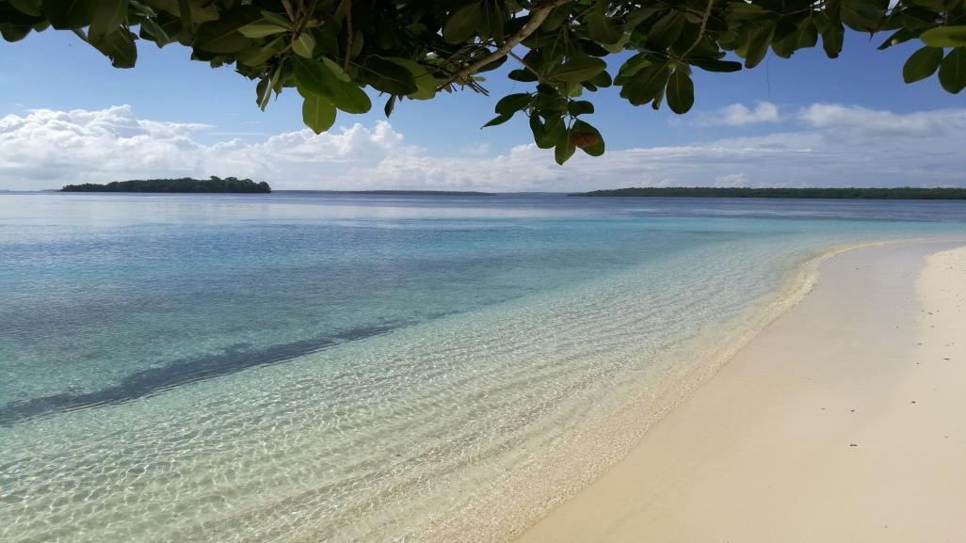
PNG’s Economy
Introduction
Business perspective and local politician
PNG’s Development experience since Independence
PNG’s Resource Curse again
APEC Opportunities
Jobs and Growth Crisis
Exchange Rate Crisis
Budget Crisis
Alternative Government Policies
Conclusion
lemus island.kavieng.new ireland province.png

Slide 3
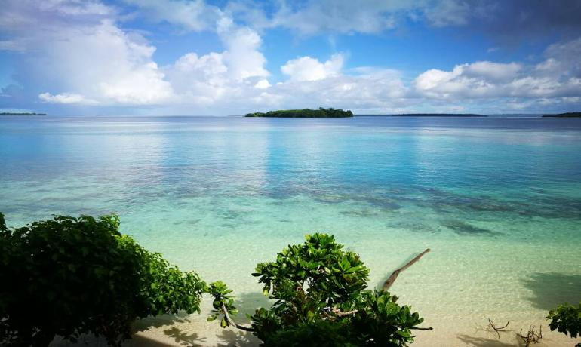
Business Perspective and Local Politician
lemus island.kavieng.new ireland province.png

Slide 4
PNG’s Poor Social Indicators relative to Asia-Pacific peers (45 countries)
In PNG, an estimated 39.3% of the population live below the $US1.90 per day poverty line in 2014. This is by far the lowest of the 26 countries with information (the next lowest is 21.2% in India).
The prevalence of stunting amount children under the age of 5 is 49.5%, ranking 29th of the 30 countries with only Timor-Leste having a slightly higher figure of 50.2%.
The prevalence of malnutrition (wasting) among children under 5 is 14.3%, the highest rate for the 30 countries.
The maternal mortality ratio per 100,000 live births is 215, the equal 3rd highest of 40 countries with information.
The under 5 mortality rate per 1,000 live births is 57, the 4th highest of 43 countries.
The tuberculosis incidence per 100,000 population is 432, the 2nd highest of 44 countries.
The incidence of malaria per 1,000 population is 185, nearly double the next highest country of 90 in Timor Leste.
The Mortality Rate Attributed to Unsafe Water, Unsafe Sanitation, and Lack of Hygiene is 12.4, 7th of 40 countries.
The Proportion of Population Using Improved Drinking Water Sources is 40%, by far the lowest of the 43 countries (the next rate is Afghanistan with 55.3%)
The proportion of the population with access to electricity is 20.3%, once again significantly below the next lowest ranking country of Vanuatu with 34.5%.

Slide 5
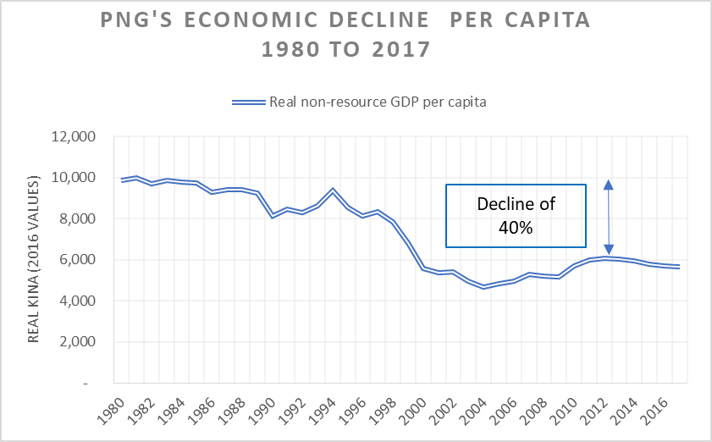
Source: PNG Economics website: http://pngeconomics.org/policy-analysis/png-macro-economic-performance/png-not-living-up-to-its-economic-potential/

Slide 6
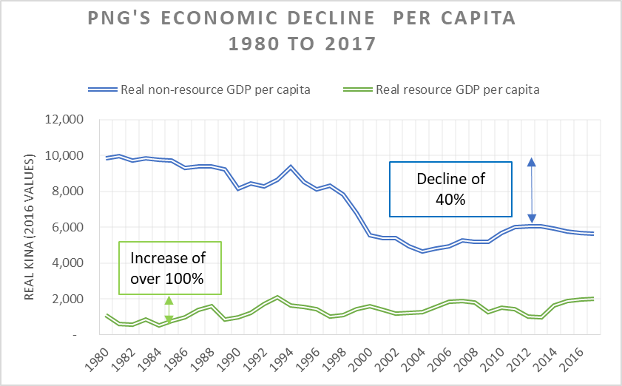
Source: PNG Economics website: http://pngeconomics.org/policy-analysis/png-macro-economic-performance/png-not-living-up-to-its-economic-potential/

Slide 7
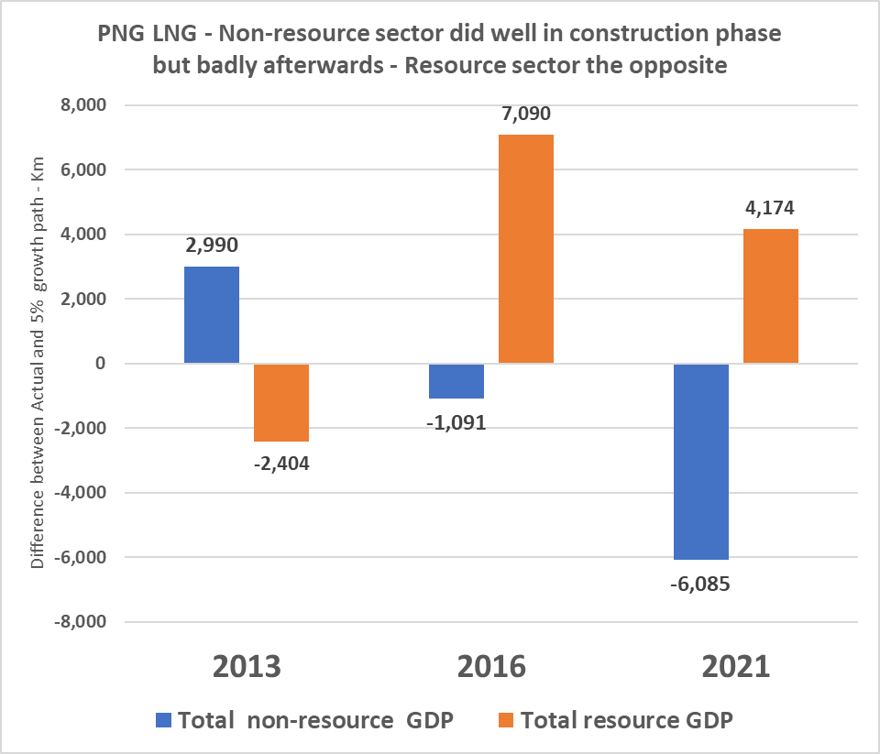

Slide 8
Resource Curse Elements
Exchange rate over-valuation hurts other exporters (especially agriculture and tourism) and trade-competing industries such as manufacturing
Pre-source curse – spending too much before resource revenues are received, and deep budgetary problems
Diversion of skilled labour and investment to the resource sector
Risk of increased corruption
Lack of focus on other sectors such as agriculture

Slide 9
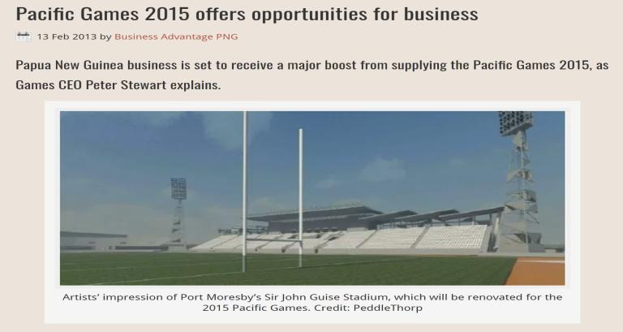
APEC Opportunities – be cautious of promises and ensure correct policies in place for benefits

Slide 10
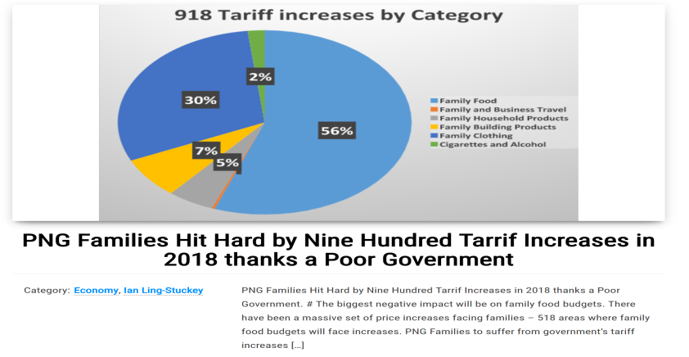
Tariff increases and increasing protectionism contrary to spirit of APEC

Slide 11
Jobs and Incomes Actions
Different philosophy of economic development based around economic empowerment for its people rather than big government. For example, the Alternate Government would:
  redirect funds going to the proposed equity investments in big agricultural enterprises owned by the government’s besties and instead put this money into improving agricultural extension services for small-holder cash cropping farmers;
  put road infrastructure funding into rural areas rather than Port Moresby;
  get incentives right for business rather than imposing large tariffs that hurt the cost of living;
  deal with the foreign exchange shortages which are killing business growth.
5% income growth target (real non-resource GDP per annum) within 3 years – up from 2%. NA did this in the 2000s in recovering from 90s crisis and can do it again.
SME and informal sector focus through better business environment – better access to credit, better regulation, easier to set up a business, easier to trust contracts, - measured by improving PNG’s rankings on ease of doing business from 119th to 100th of 190 countries within 5 years.

Slide 12
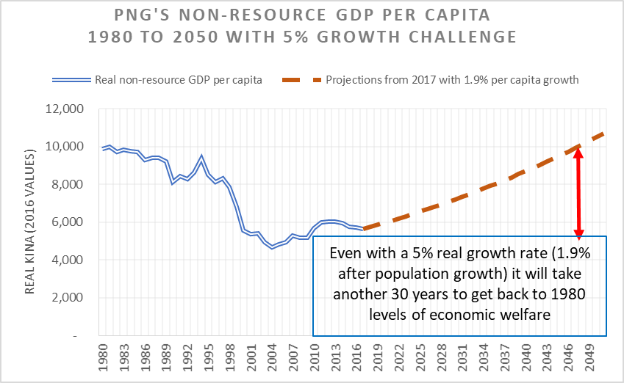
A long road back to improvements

Slide 13
2015 and 2017 - Worrying Recent developments
PNG’s National Statistics Office took nearly 10% off the estimated size of the PNG economy for 2015, reducing it from K62.3 billion (PNG 2018 Budget figure) down to K57.1 billion.
Nominal GDP growth was slashed from 9.8% to only 0.7%, and after allowing for PNG LNG exports increasing by K4.2 billion, this means the non-resource sector must be in a severe recession – probably going backwards by well over 5% after allowing for inflation. But the government is hiding these figures and refusing to release the full set of tables.
For 2018, the central bank governor in his Monetary Policy Statement said GDP growth should be higher than the PNG Treasury estimate at 3%, but Moody’s international rating agency expected the figure would be only 0.5% in 2018, and the Asian Development Bank released a growth estimate of only 1.8% in the latest Asian Development Outlook publication.
The S&P credit rating agency downgrade is a real knock to the PNG economy. It is only the second time that PNG’s credit rating has been downgraded by S&P – the first time was in August 2001 as PNG struggled with the late 1990s crisis.
The government is not doing enough about the foreign exchange crisis. BPNG Governor claiming their will be a balance of payments surplus of K1.5 billion in 2018. But this was before the earthquake, and loss of 2 months of PNG LNG exports of K2 billion, the most likely outcome is now a loss of K500 million in foreign exchange reserves.
Treasurer Abel is claiming the IMF has endorsed its medium-term fiscal strategies, but the 2018 budget over-spent the IMF’s understandings by K2 billion, and then invented fake revenue of at least K1.5 billion above its optimistic scenario.
the Treasurer says they kept to the 2.5% deficit figure in 2017, but this is a fiction and reflects an increasing tendency to fiddle the books. in Parliament, we have had two government ministers admit that there are massive unpaid bills – over K700 million in public works alone – and this leads to mis-representing the true state of PNG’s public finances.
And as a true sign of how the private sector is still struggling and has lost confidence in the word games of this government, private sector credit-loans for business investment and housing, decreased by 3.4% in 2017 even before allowing for inflation.

Slide 14
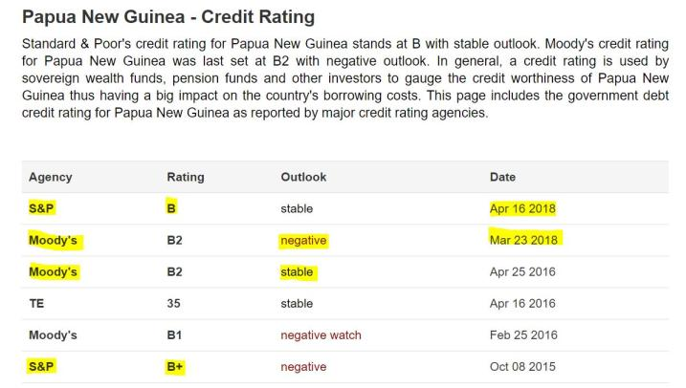
Historic Credit Ratings Downgrade – Outsiders are looking through fake figures

Slide 15
Jobs and Incomes Actions (repeat)
Different philosophy of economic development based around economic empowerment for its people rather than big government. For example, the Alternate Government would:
  redirect funds going to the proposed equity investments in big agricultural enterprises owned by the government’s besties and instead put this money into improving agricultural extension services for small-holder cash cropping farmers;
  put road infrastructure funding into rural areas rather than Port Moresby;
  get incentives right for business rather than imposing large tariffs that hurt the cost of living;
  deal with the foreign exchange shortages which are killing business growth.
5% income growth target (real non-resource GDP per annum) within 3 years – up from 2%. NA did this in the 2000s in recovering from 90s crisis and can do it again.
SME and informal sector focus through better business environment – better access to credit, better regulation, easier to set up a business, easier to trust contracts, - measured by improving PNG’s rankings on ease of doing business from 119th to 100th of 190 countries within 5 years.

Slide 16
Exchange Rate Crisis Actions
Acknowledge there is a crisis and the government can do things, not just BPNG.
1. Short-term – stop spending FX on big equity investments best left to private sector such as USD254m lost on Oil Search and USD120m for Nautilus; bring back foreign currency eg K2 billion Kumul Petroleum in Singapore; use $US50m of foreign exchange reserves each month to help clear backlog; reach out for friendly concessional finance.
2. Medium-term – review foreign exchange system with balanced emphasis on growth and not just price stability; consider gradual shift back to freely convertible currency with appropriate adjustment support; review fx hungry approach to government equity stakes in large resource projects.
3. Longer-term – vision of filling the supermarket shelves of Asia, not just Port Moresby. Focus on being internationally competitive – 2-pronged approach dealing with import substitution as well as export opportunities with more jobs and incomes for rural areas. Let’s not repeat the 45 year old Ramu Sugar legacy – massive costs on PNG consumers but little long-term benefit in sustainable jobs.

Slide 17
Budget Crisis Actions
Face the facts – first step to finding a solution is accept how bad the problem is. 2018 Budget’s K2 billion fake revenue numbers will just make the pain of adjustment more difficult. Need an audit of government books to find out how much debt is being hidden in Kumul entities.
Friendly concessional finance – budget hole is so deep PNG can no longer do it on its own. Need to lower interest costs and bring in foreign exchange – not expensive Sovereign Bond and tied, unaccountable Chinese loans.
Realistic revenue estimates – can’t keep living in illusion of world of fake revenue numbers. Build revenue base – more tough measures required.
Remove budget austerity on key areas of health, infrastructure, law and order and education – too much slashing, need to restore and acknowledge pressures of population growth.
Cut wasteful spending on less important areas such as the bloated public service and “big projects” such as APEC and sporting games – cheaper ways to promote PNG.
Lower interest costs -Greater confidence in government will improve credit ratings and help lower domestic interest costs saving hundreds of millions of Kina.

Slide 18
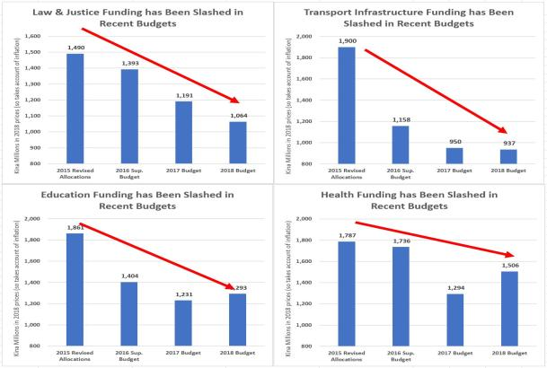
Massive budget cuts in key sectors since 2015

Slide 19
Alternative Government Policies
See website - http://www.opposition.gov.pg/
Budget response speech - http://www.opposition.gov.pg/wp-content/uploads/2017/12/2018-BUDGET-REPLY-SPEECH-FINAL-DRAFT.041217ILS.11.04PM-16FONT.pdf
Plans for series of Alternative Government Policies
  Examples of these action-orientated policies for the economy have been included in the above slides
  Comments on the draft policies would be welcome – email me at chairman@kdda.gov.pg
Encourage you closely monitor some good economic websites
  I subscribe to World Bank, ADB, IMF, UN (although stronger on social issues), ANU Development Policy, PNG Economics, Lowy Institute.

Slide 20
PNG’s Economy
Introduction
Business perspective and local politician
PNG’s Development experience since Independence
PNG’s Resource Curse again
APEC Opportunities
Jobs and Growth Crisis
Exchange Rate Crisis
Budget Crisis
Alternative Government Policies
Conclusion

