Slide 1



UPDATE CONFERENCE: YEAR OF THE APEC, UPNG, WAIGANI:
ROLLER-COASTER:
“THE CHALLENGE OF USING TEACHING AND LEARNING AS OPPORTUNITY FOR TEACHER PROFESSIONAL DEVELOPMENT”
Russel Kitau, Division of Public Health, School of Medicine and Health Sciences, University of Papua New Guinea, Doctor of Education Student, James Cook University, 15th June 2018

Slide 2
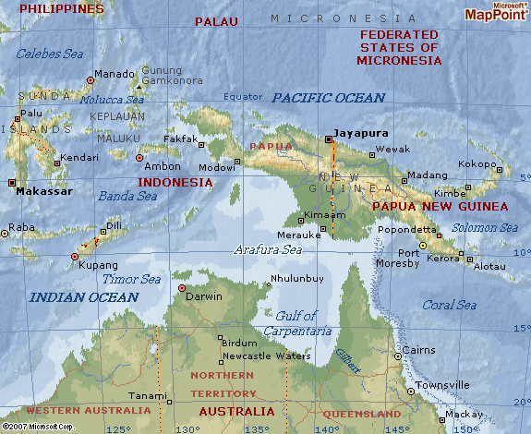
2. BACKGROUND CONTEXT
MY BACKGROUND
STUDY SITE
Background about myself RK,
Early education and professional experience,
Research challenges I faced as university lecturer,
Why I decided to do the professional doctorate?

Slide 3
3. AIM AND RATIONALE
Roller-coaster is a Professional Doctor of Education thesis by publication. It describes the key steps I have taken as lecturer in public health to use my teaching and learning activities as opportunity to address my own research higher degree needs.
As Acting Chairman of the Division of Public Health (DPH) at the UPNG School of Medicine and Health Sciences (SMHS) at the commencement of the study, I needed to address my own professional development needs in order to better support colleagues in similar situations as me to address their own needs.
To achieve this aim four main goals were set: to develop skills in literature search and reviews; develop understanding and hands-on-experience with qualitative thematic analysis; develop skills in basic quantitative analysis; and strengthen my academic writing and publishing capacity by sharing and disseminating research findings through peer reviewed journals, newsletters, conferences and other presentations.
Instead of researching a single topic in-depth outside my routine teaching activities as is usually the case with conventional PhD, the professional doctorate allowed me to write for different kinds of audiences and to submit a portfolio of research outputs based on my day to day work.

Slide 4
4. METHODOLOGY
IS IT POSSIBLE FOR UNIVERSITY TEACHERS INCLUDING IN RESOURCE – POOR COUNTRIES TO USE TEACHING AND LEADING ACTIVITIES AS OPPORTUNITY TO ACHIEVE THEIR PROFESSIONAL DEVELOPMENT GOALS?
The study was guided by two related research questions: a) what were the main challenges and opportunities involved in using teaching and learning activities to achieve my research higher degree goals; and b) how can this experience help me to better support colleagues in similar situations.
To answer these questions, a mixed methods approach, informed by a range of transformational and pragmatic world views including problem-based learning, empowerment, participatory learning-by-doing, and auto ethnography, was taken.
To ensure the authenticity of the narrative, I have written significant sections of this doctoral study in the first person.

Slide 5
5. RESULTS AND DISCUSSION
IS IT POSSIBLE FOR UNIVERSITY TEACHERS INCLUDING IN RESOURCE – POOR COUNTRIES TO USE TEACHING AND LEADING ACTIVITIES AS OPPORTUNITY TO ACHIEVE THEIR PROFESSIONAL DEVELOPMENT GOALS?
EVIDENCE: Three peer reviewed journal articles are presented as evidence that I achieved the professional development goals I set myself: review of gender policies and programs in Papua New Guinea (PNG); implementation of the Aboriginal Australian Family (FWB) empowerment program in the context of University of Papua New Guinea (UPNG) public health teaching; and the feasibility of transferring the FWB from university to PNG community setting. Newsletter articles and other research outputs are also presented in the appendix as additional supporting evidence.
YES. THE STUDY HAS SHOWN THAT IT IS POSSIBLE FOR UNIVERSITY TEACHERS INCLUDING IN RESOURCE – POOR COUNTRIES TO USE TEACHING AND LEADING ACTIVITIES AS OPPORTUNITY TO ACHIEVE THEIR PROFESSIONAL DEVELOPMENT GOALS. HOWEVER, THE JOURNEY, AS I HAVE EXPERIENCED IT, WAS LIKE A ‘ROLLER-COASTER’ WITH HIGH AND LOW MOMENTS.

Slide 6
6. KEY CHALLENGES
Key challenges include a steep learning curve, lack of money, time constraints, tiredness, sickness, and family responsibilities.
Despite the many challenges, the reflective learning-by doing approach taken allowed me to use the challenges as opportunities to learn and grow. By routinely reflecting on what was working and not working and how to make things better, I was reminded of the often little but significant incremental progress I was making along the way, especially during the difficult or low moments.
Overall, insights gained from my study highlight the nature of empowerment and how this might be fostered or cultivated in the context of health workforce development in PNG. A range of study limitations and suggestions for future research are highlighted.

Slide 7
7. STUDY LIMITATIONS
Study based on data collected through previous FWB pilot study and research training and fieldwork activities for which ethics approval was obtained.
Lack of experience. Even though I had support from JCU at the time of collecting the data, there was a gap.

Slide 8
8. RECOMMENDATIONS
GOAL | STUDY SIGNIFICANCE? | FUTURE RESEARCH?
1,2,3,4 | The reflective approach to my doctoral journey informed by both auto-ethnography and PBL principles provides a practical framework for university lecturers embarking on similar professional development journeys. | Examine ways to support new doctorates to become independent researchers and research leaders so they in turn can support next generation of researchers in an on-going capacity development cycle.

Slide 9
9. ACKNOWLEDGEMENTS
Grateful Acknowledgement is made of Professor Komla Tsey, Principal Advisor, JCU
Professor Komla Tsey was ably assisted by:
Dr. Mary Whiteside, La Trobe University
Dr. Irina Kinchin, Central Queensland University
Dr. Goru Hane-Nou, University of Papua New Guinea
My colleagues, students
My Family (wife and son Junior)

Slide 10
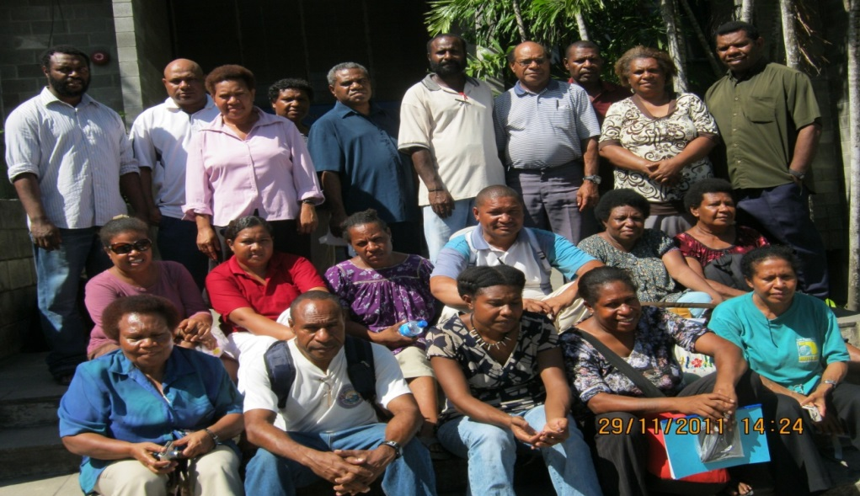
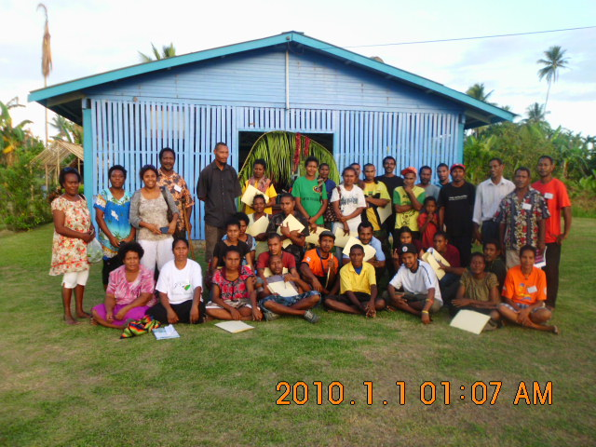
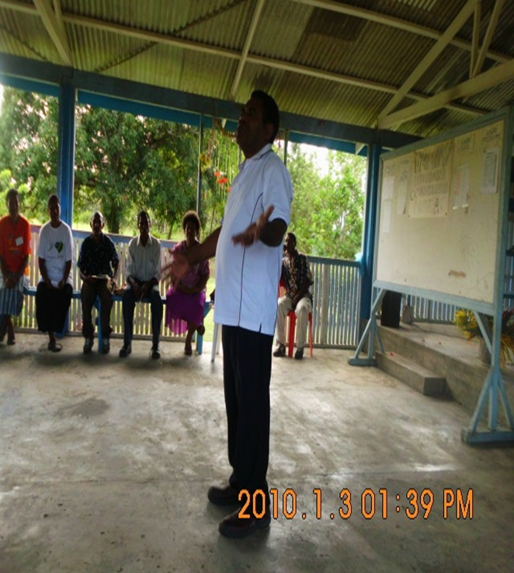
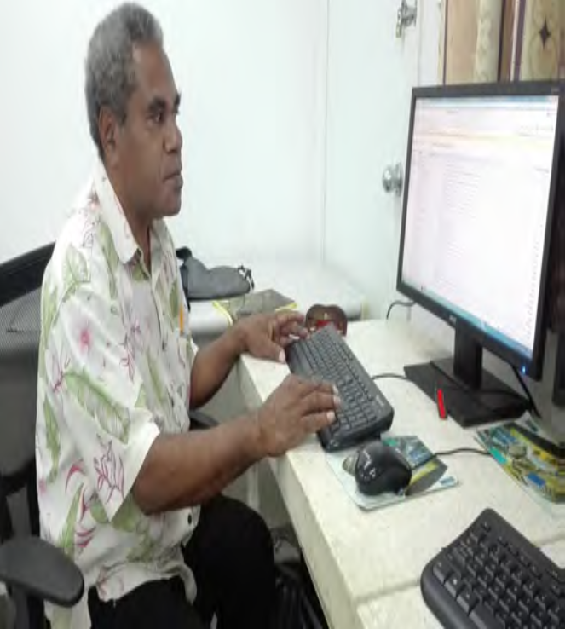

Slide 11
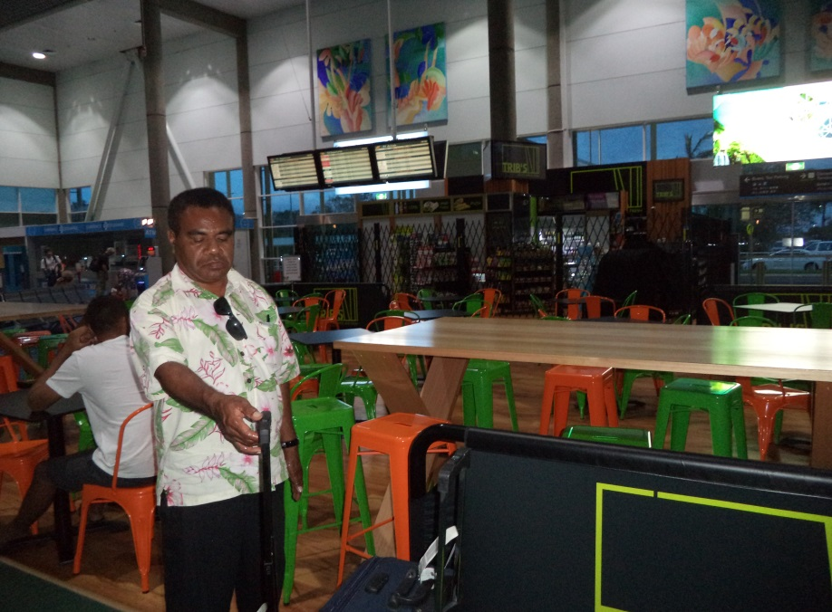
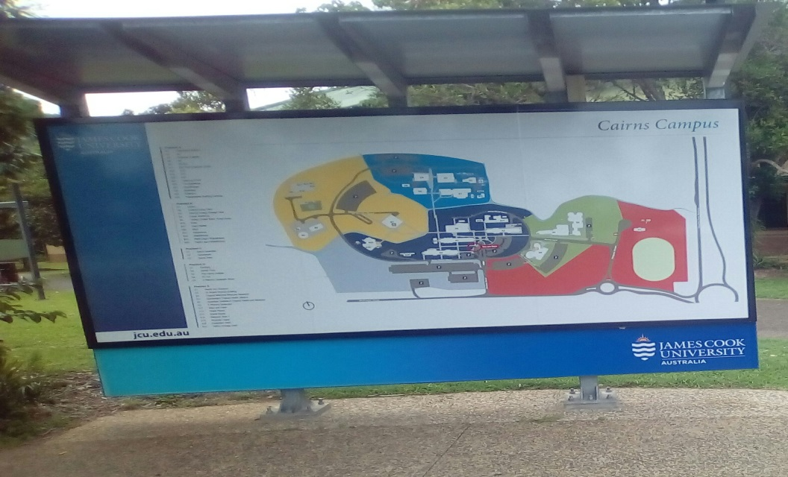
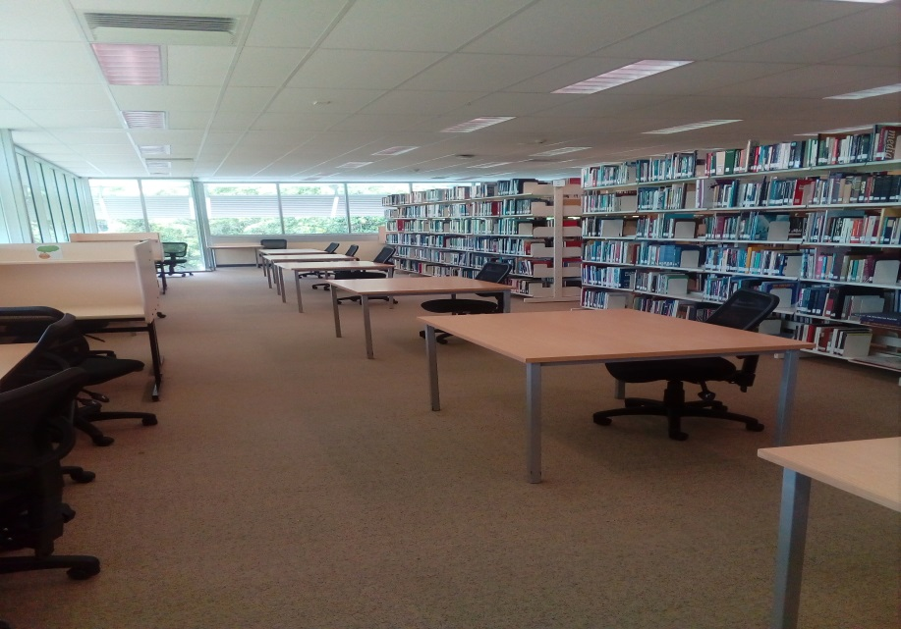
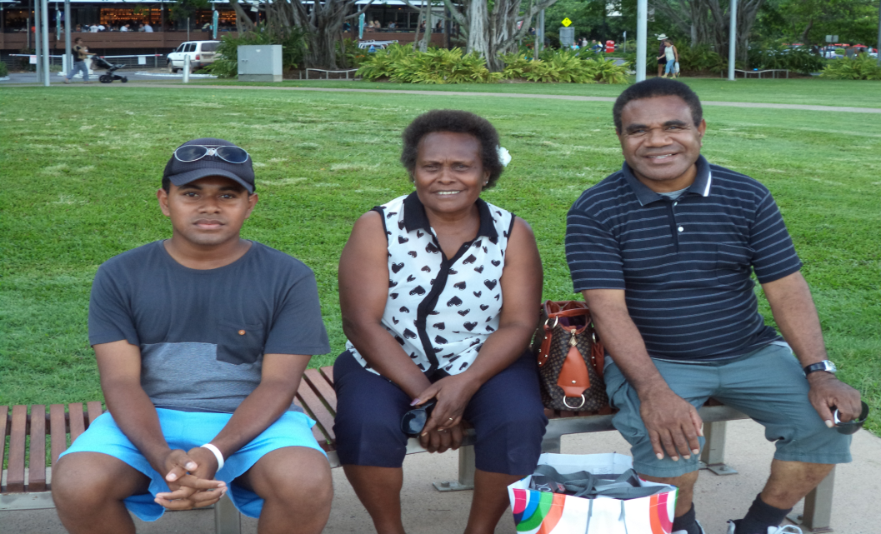

Slide 12
Abstract
Aim and rationale: Roller-coaster is a Professional Doctor of Education thesis by publication. It describes the key steps I have taken as lecturer in public health to use my teaching and learning activities as opportunity to address my own research higher degree needs. As Acting Chairman of the Division of Public Health (DPH) at the UPNG School of Medicine and Health Sciences (SMHS) at the commencement of the study, I needed to address my own professional development needs in order to better support colleagues in similar situations as me to address their own needs. To achieve this aim four main goals were set: to develop skills in literature search and reviews; develop understanding and hands-on-experience with qualitative thematic analysis; develop skills in basic quantitative analysis; and strengthen my academic writing and publishing capacity by sharing and disseminating research findings through peer reviewed journals, newsletters, conferences and other presentations. Instead of researching a single topic in-depth outside my routine teaching activities as is usually the case with conventional PhD, the professional doctorate allowed me to write for different kinds of audiences and to submit a portfolio of research outputs based on my day to day work.
Methods: The study was guided by two related research questions: a) what were the main challenges and opportunities involved in using teaching and learning activities to achieve my research higher degree goals; and b) how can this experience help me to better support colleagues in similar situations. To answer these questions, a mixed methods approach, informed by a range of transformational and pragmatic world views including problem-based learning, empowerment, participatory learning-by-doing, and auto ethnography, was taken. To ensure the authenticity of the narrative, I have written significant sections of this doctoral study in the first person.
Results and discussion: Three peer reviewed journal articles are presented as evidence that I achieved the professional development goals I set myself: review of gender policies and programs in Papua New Guinea (PNG); implementation of the Aboriginal Australian Family (FWB) empowerment program in the context of University of Papua New Guinea (UPNG) public health teaching; and the feasibility of transferring the FWB from university to PNG community setting. Newsletter articles and other research outputs are also presented in the appendix as additional supporting evidence. The study has shown that it is possible for university teachers including in resource-poor countries such as my situation at UPNG to use teaching and learning activities as opportunity to achieve their professional development goals. However, the journey, as I have experienced it, was like a ‘roller-coaster’ with high and low moments. Key challenges include a steep learning curve, lack of money, time constraints, tiredness, sickness, and family responsibilities. Despite the many challenges, the reflective learning-by doing approach taken allowed me to use the challenges as opportunities to learn and grow. By routinely reflecting on what was working and not working and how to make things better, I was reminded of the often little but significant incremental progress I was making along the way, especially during the difficult or low moments. Overall, insights gained from my study highlight the nature of empowerment and how this might be fostered or cultivated in the context of health workforce development in PNG. A range of study limitations and suggestions for future research are highlighted.
Key words: Problem Based Learning, professional development, Family, Well Being, empowerment, gender equity, program implementation, transferability, sustainability

